Slide 1
Drawing: A to Z (kind of)

Slide 2
Franz Ackermann

Slide 3
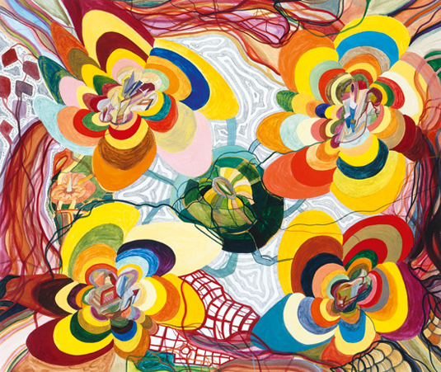

Slide 4
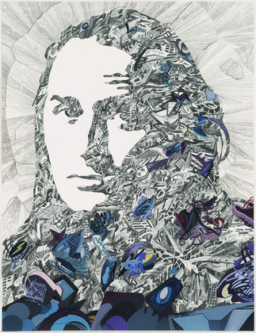

Slide 5
Kevin Appel

Slide 6
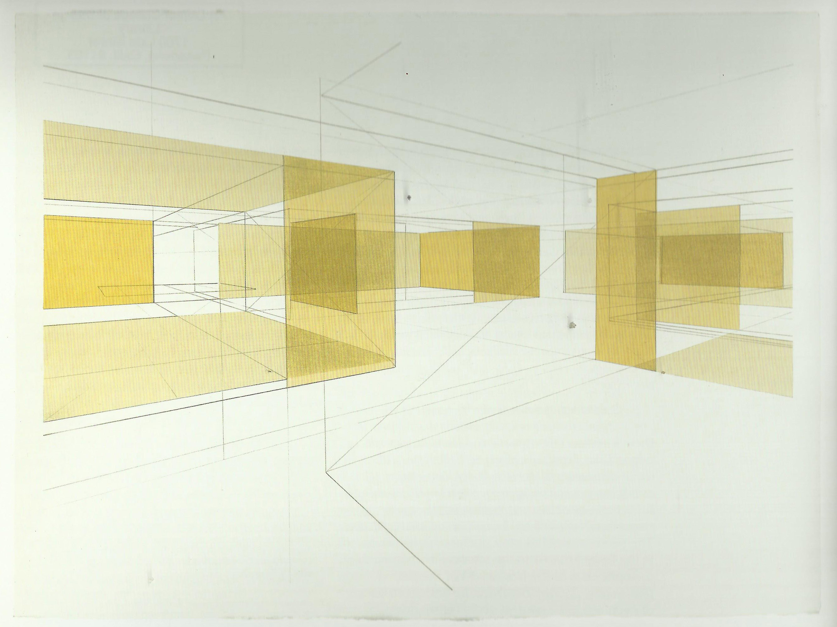

Slide 7
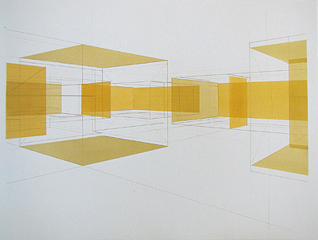

Slide 8
Jim Byrkit

Slide 9
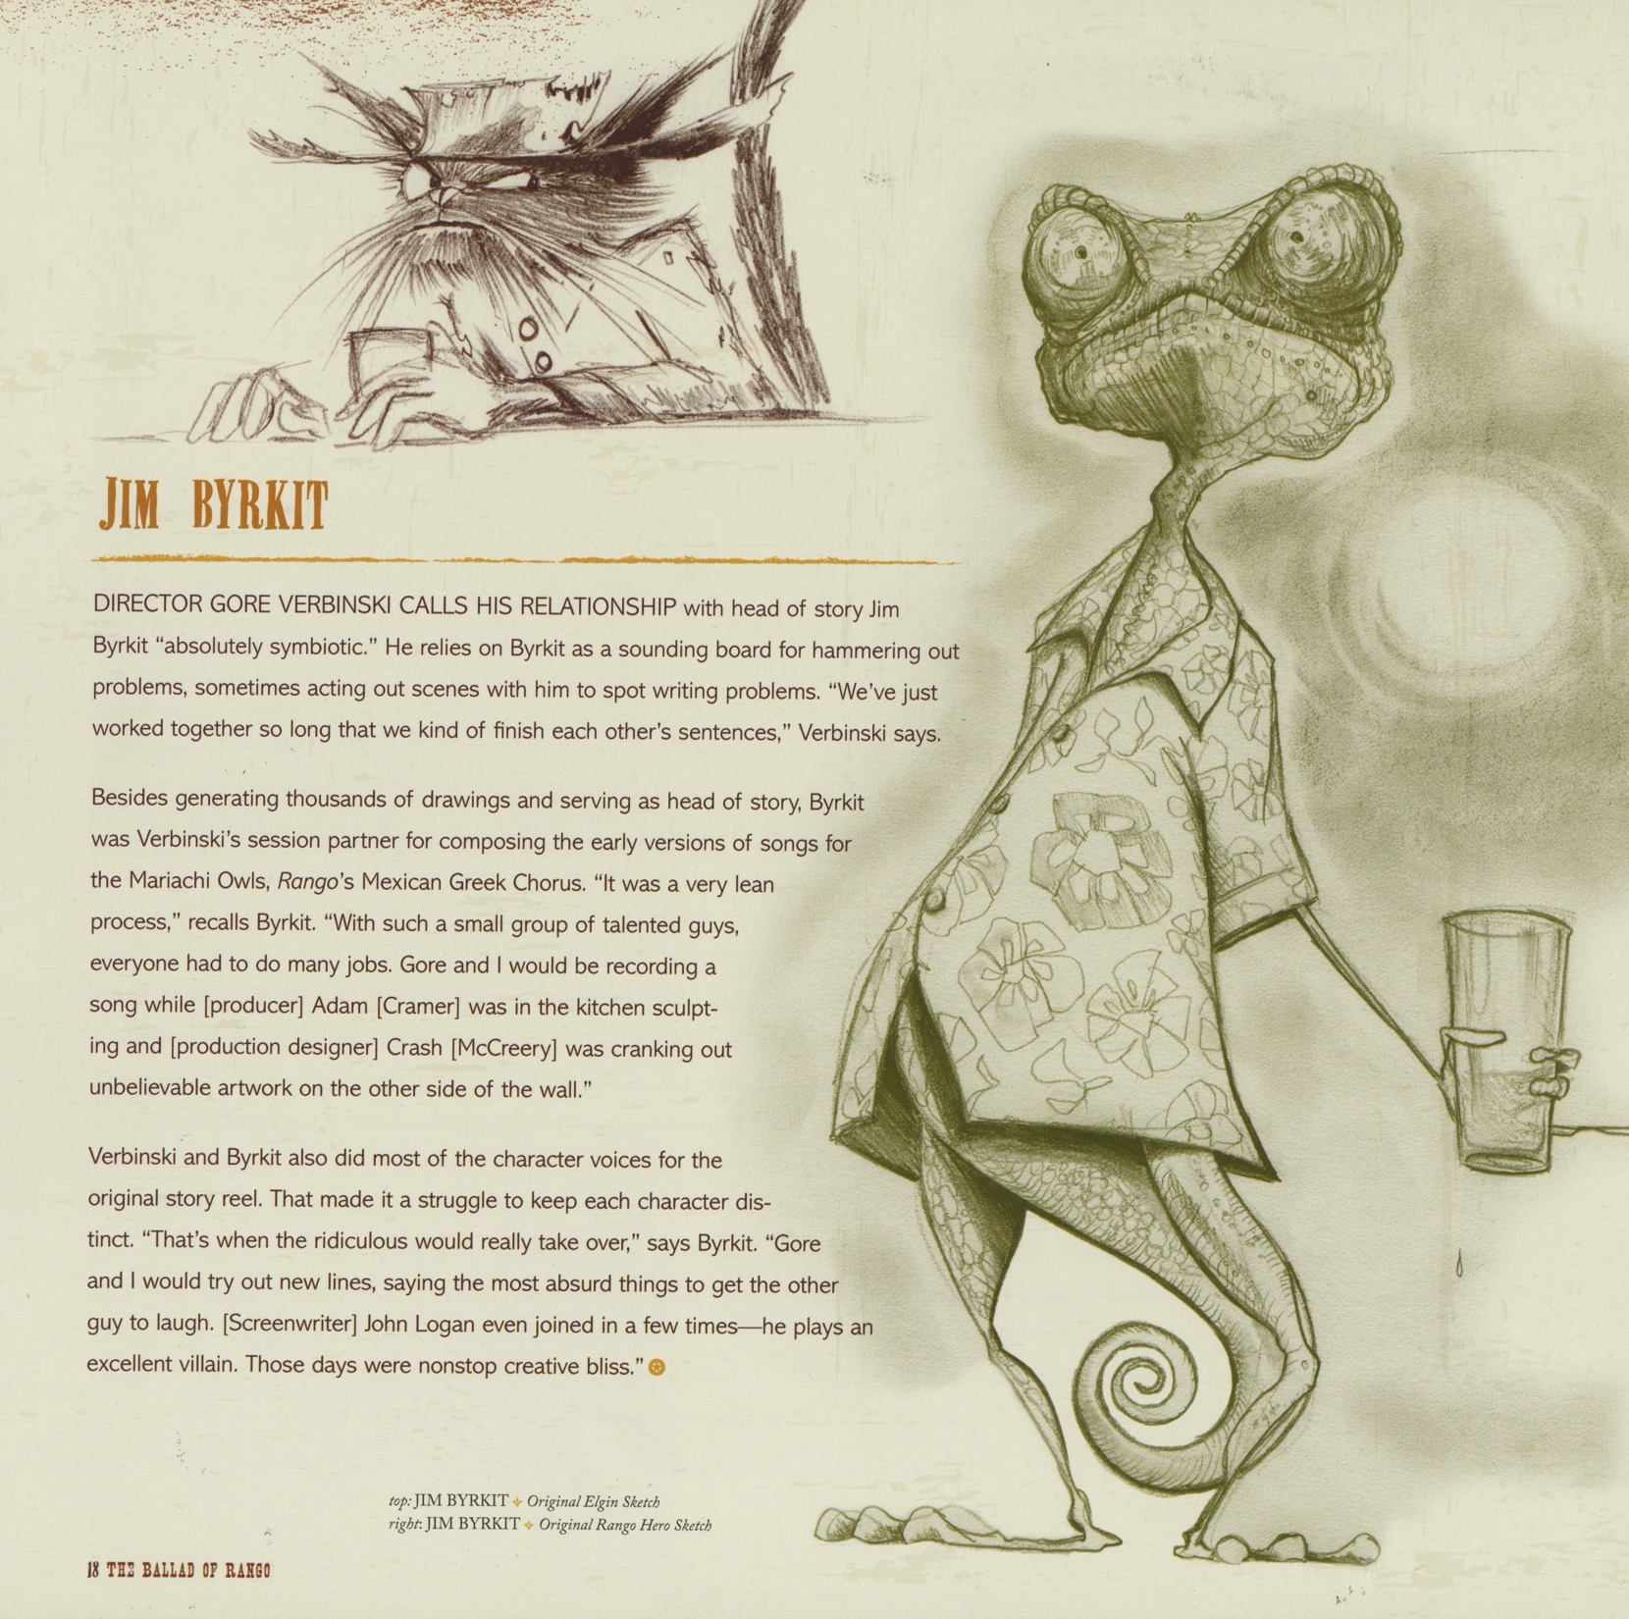

Slide 10
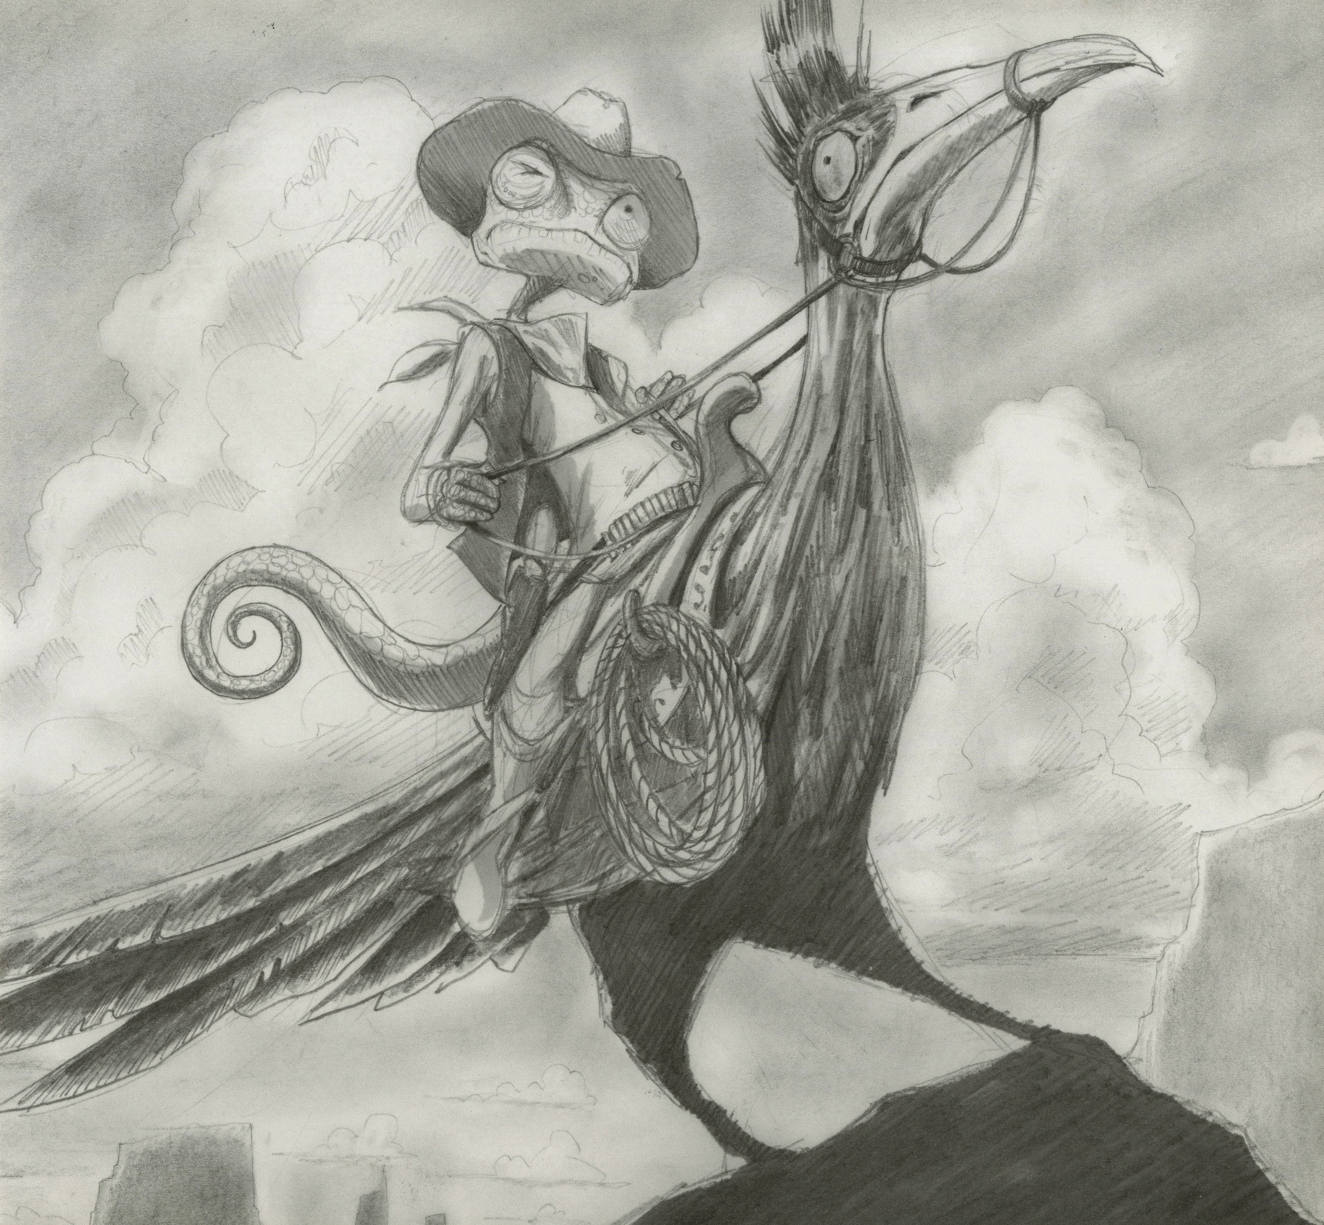

Slide 11
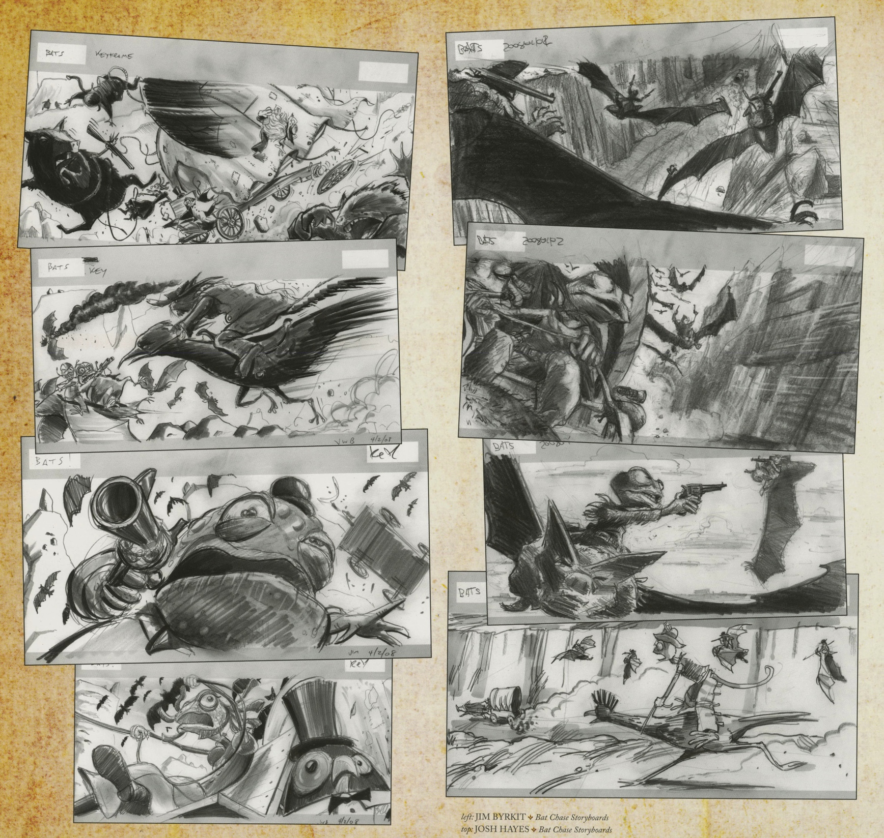

Slide 12
Charles Birchfield

Slide 13
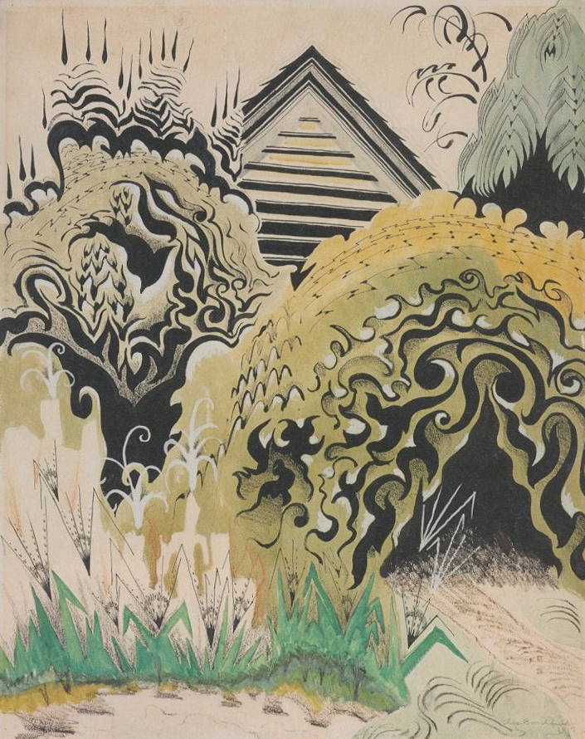

Slide 14
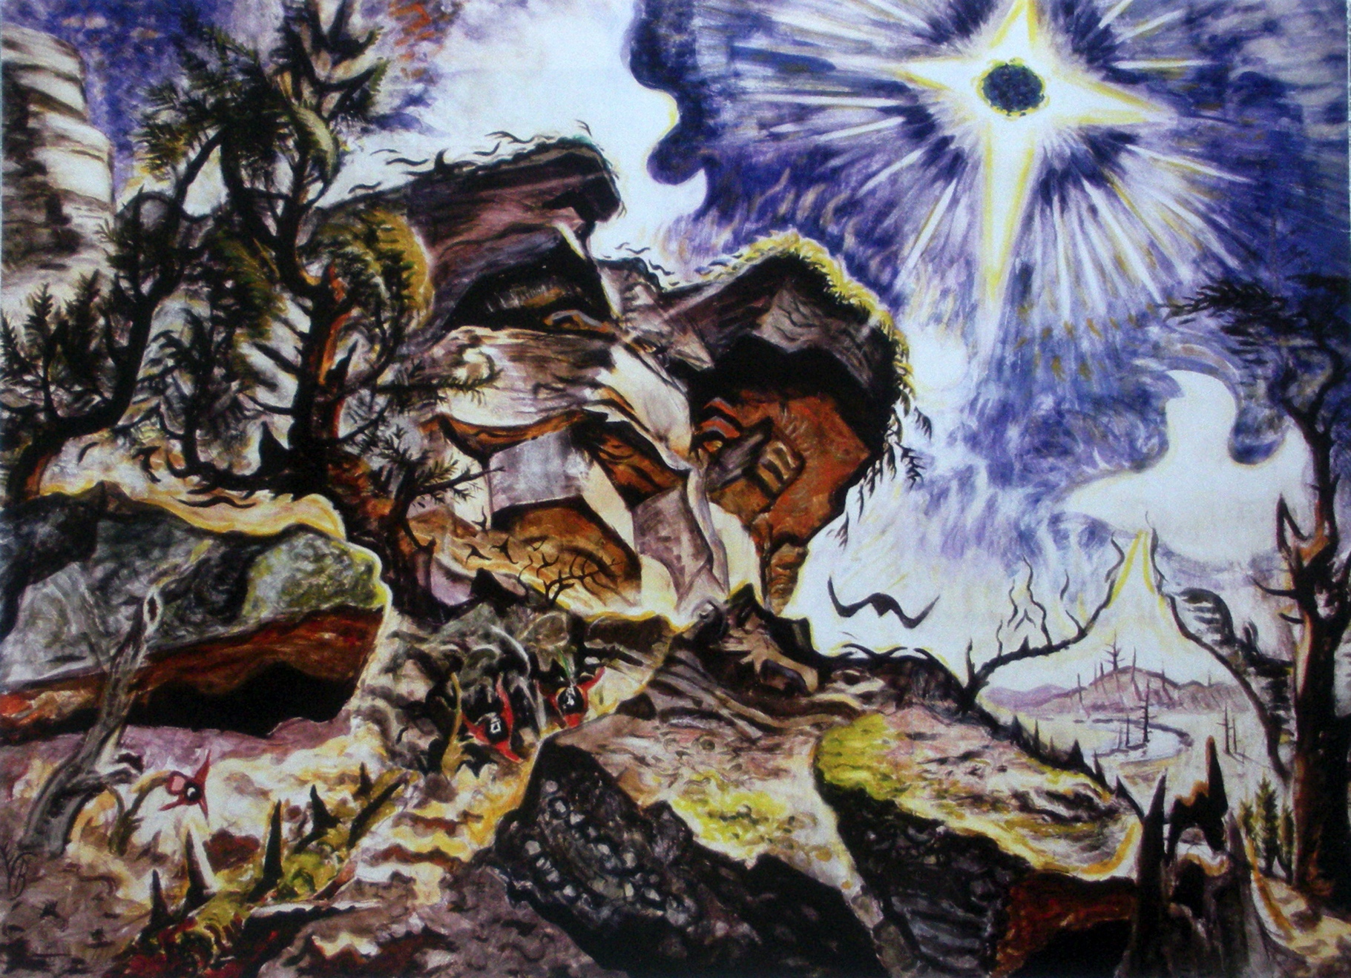

Slide 15
Santiago Calatrava

Slide 16
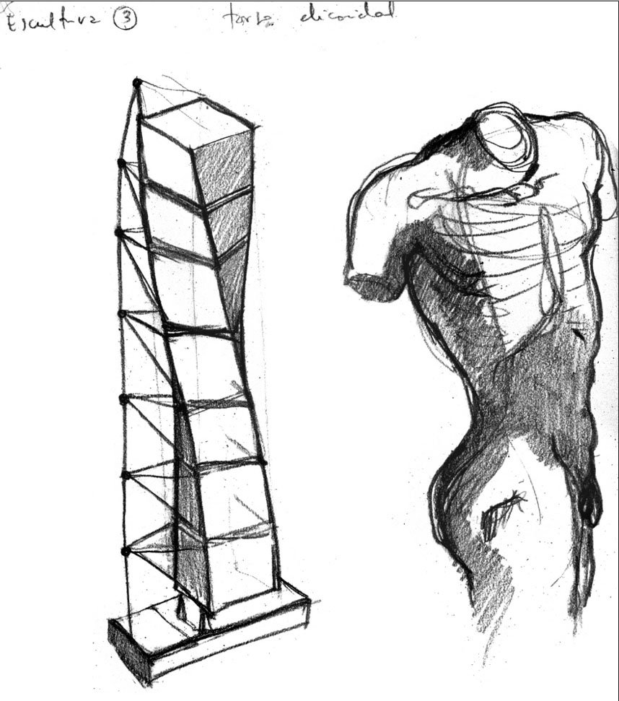

Slide 17
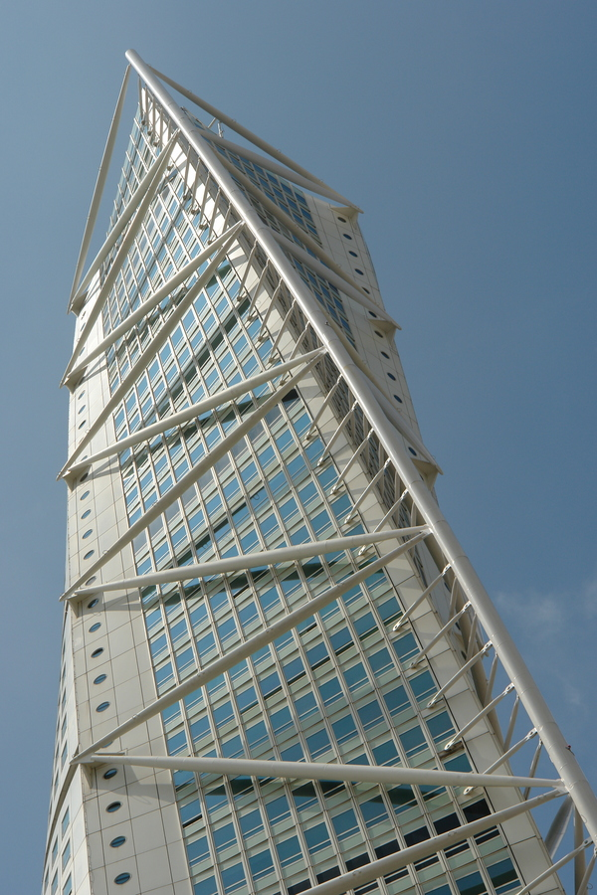

Slide 18
Howard Chaykin

Slide 19
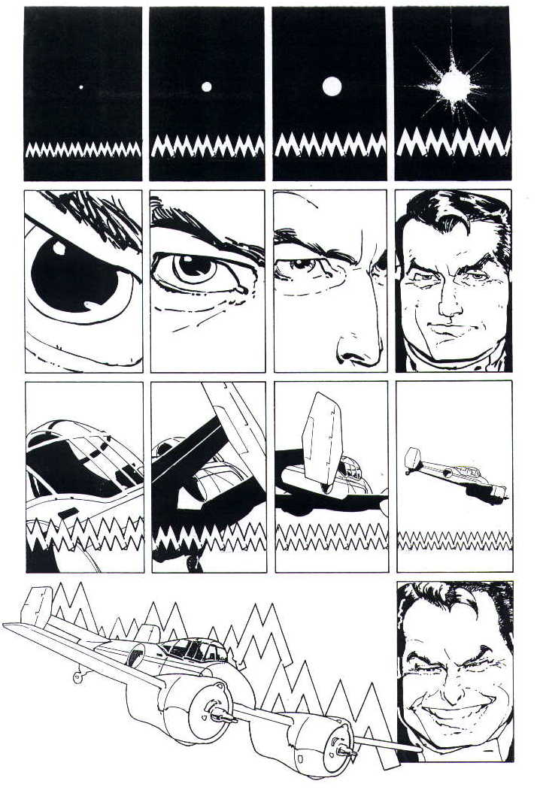
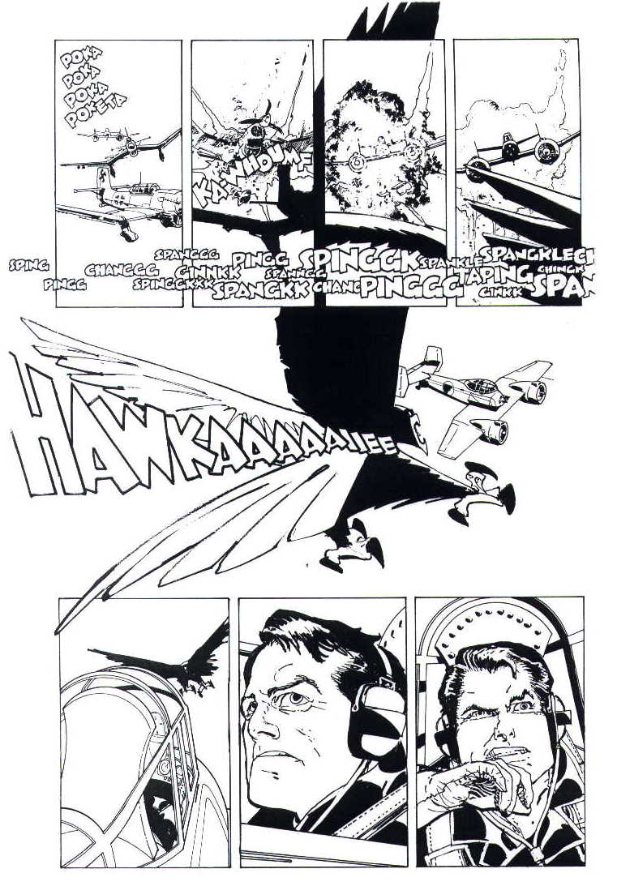

Slide 20
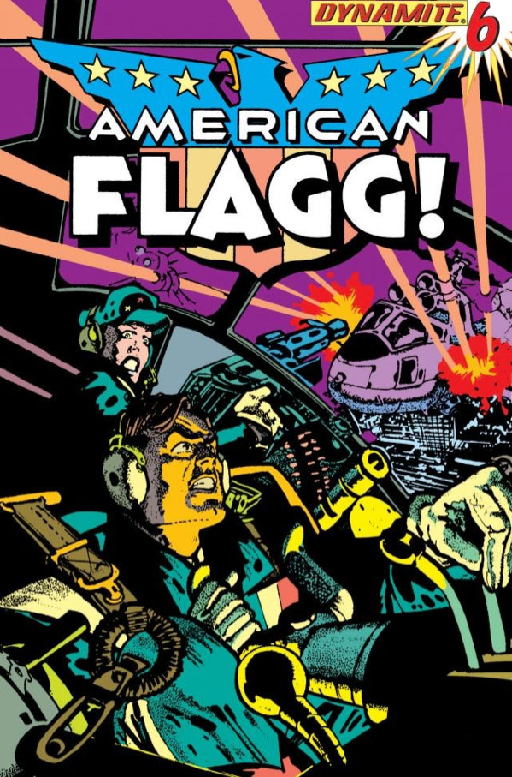
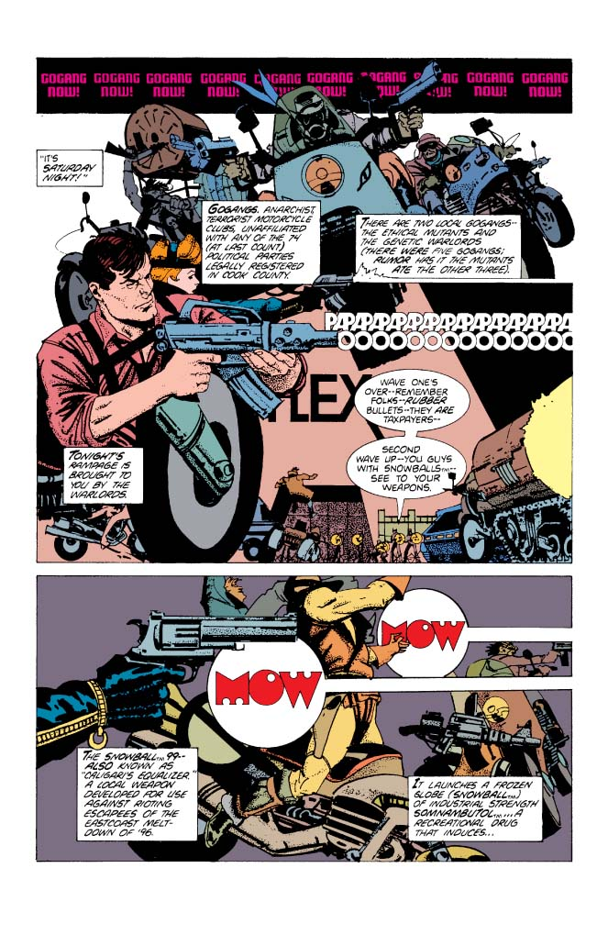

Slide 21
Leonardo da Vinci

Slide 22
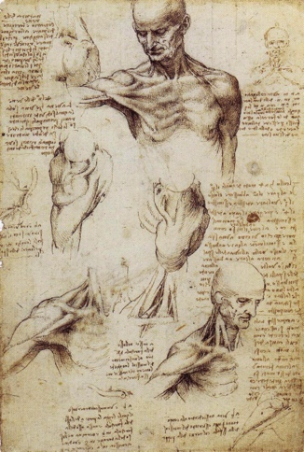

Slide 23
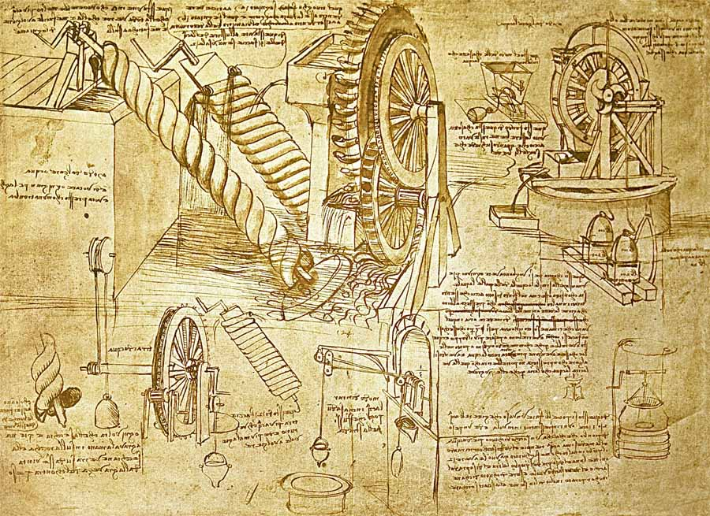

Slide 24
Geoff Darrow

Slide 25
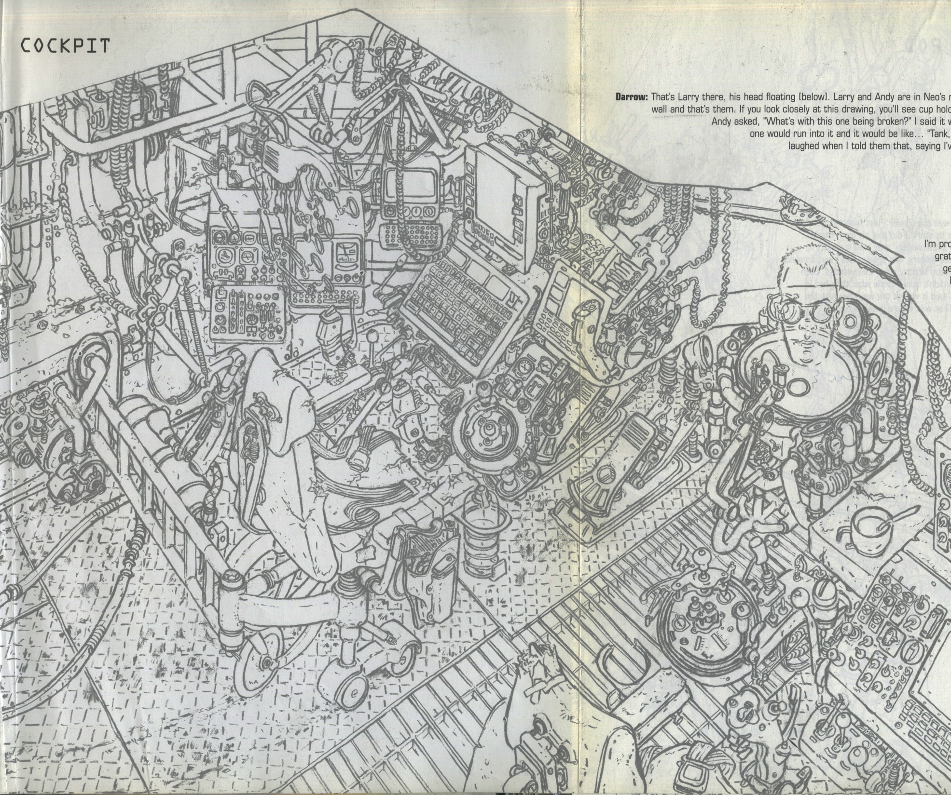

Slide 26
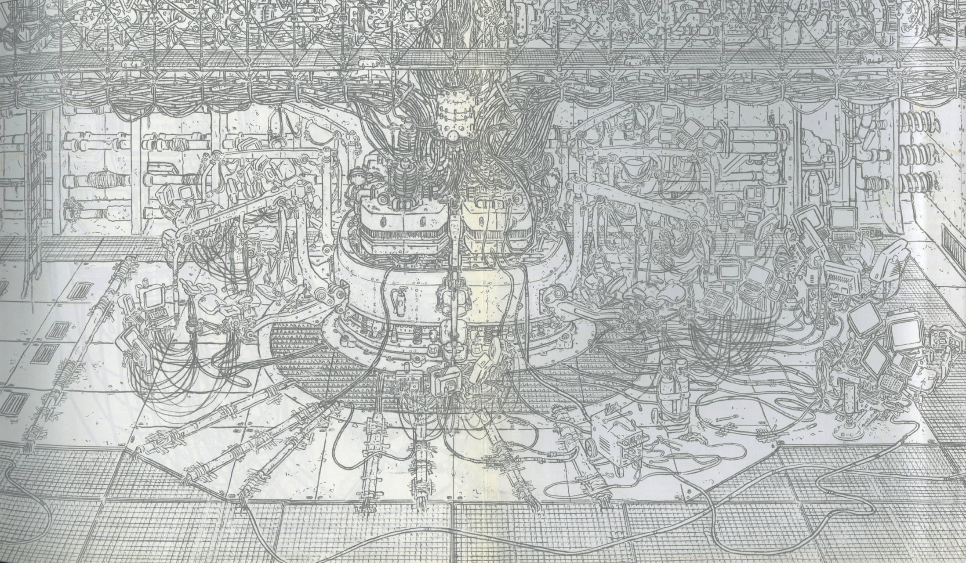

Slide 27
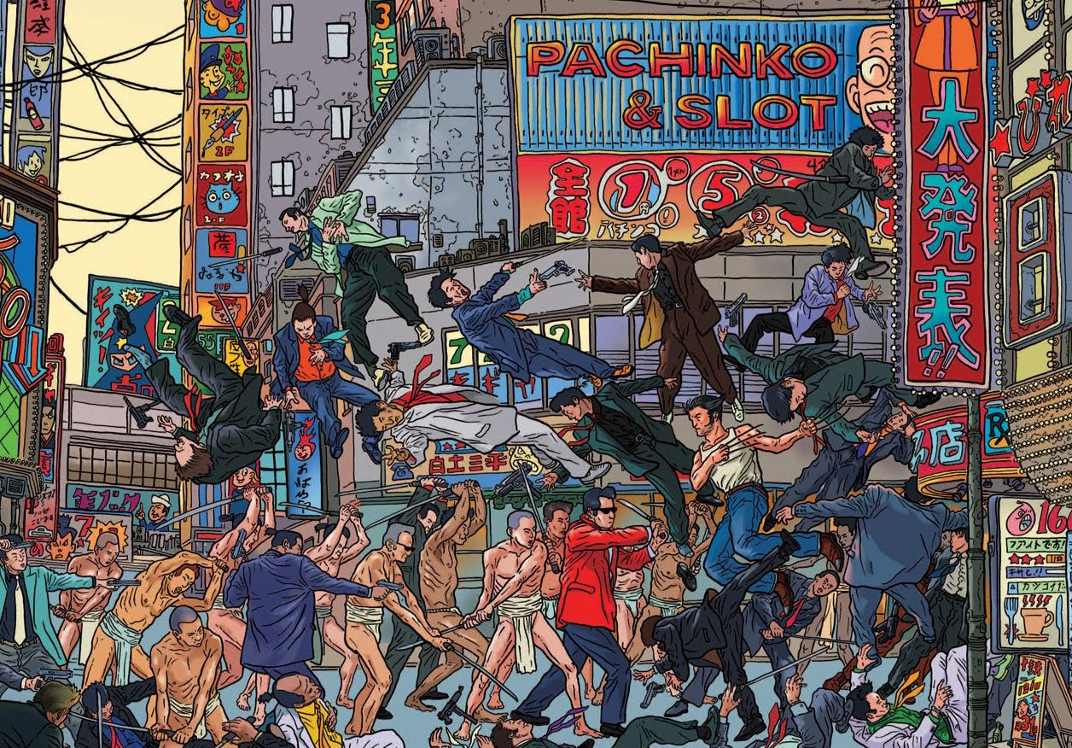

Slide 28
Jean Dubuffet

Slide 29
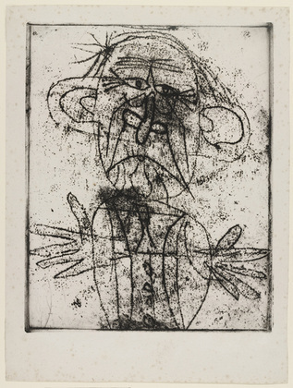
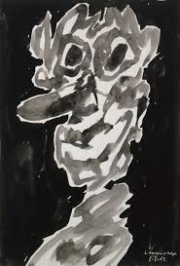

Slide 30
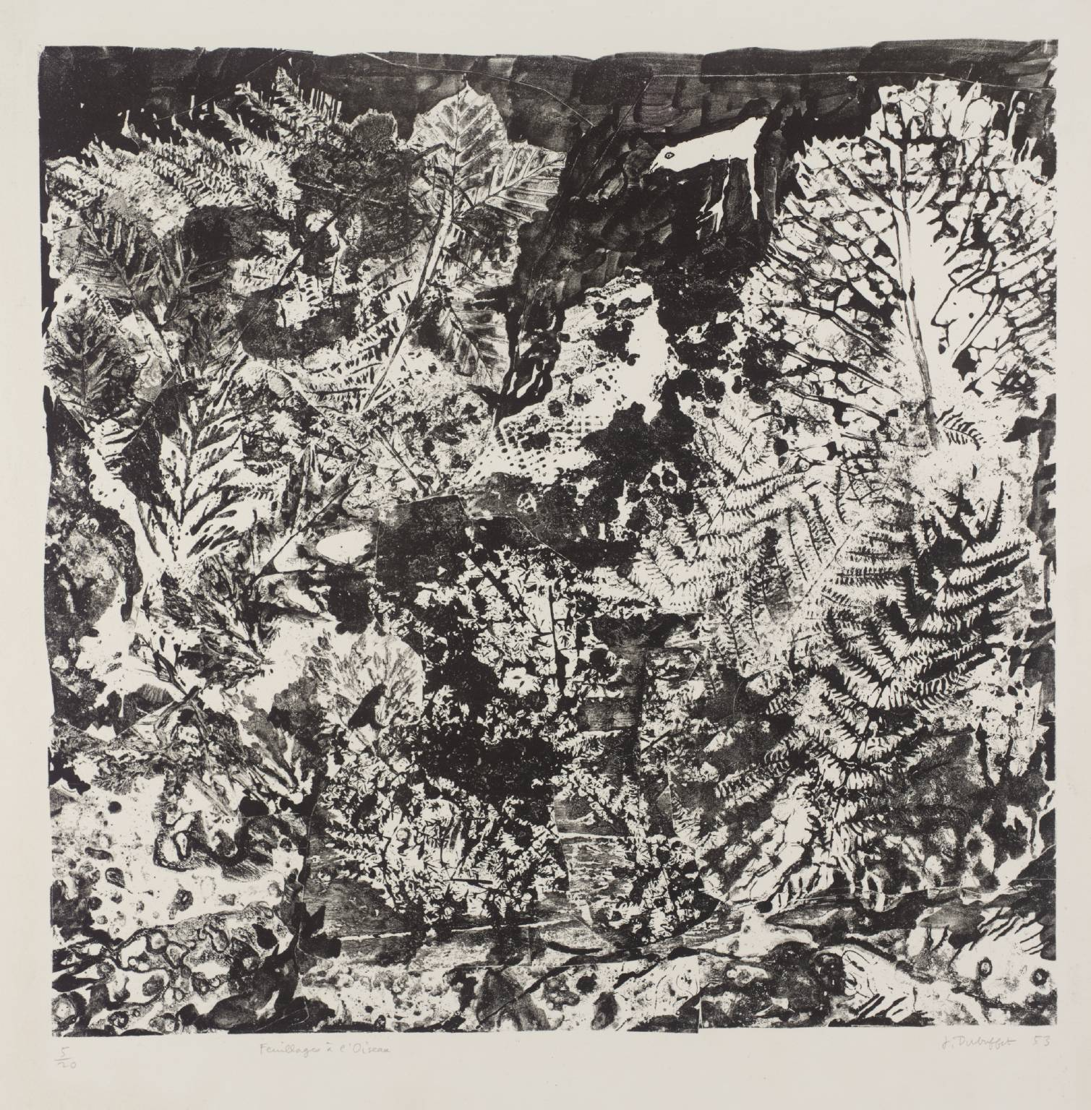

Slide 31
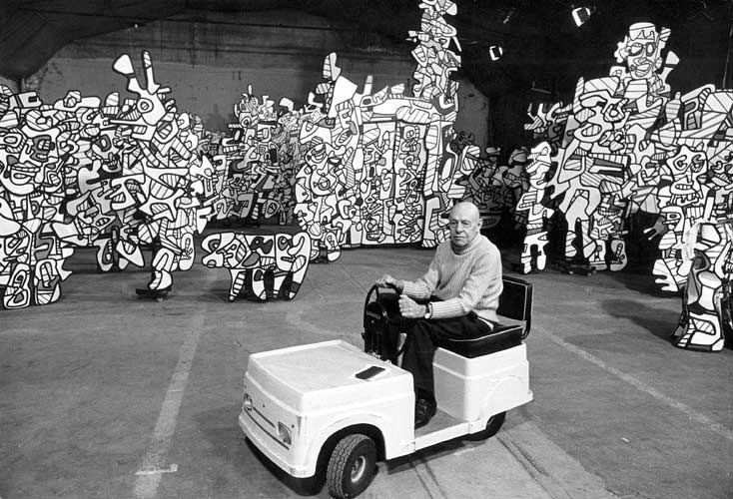

Slide 32
Henry Darger

Slide 33
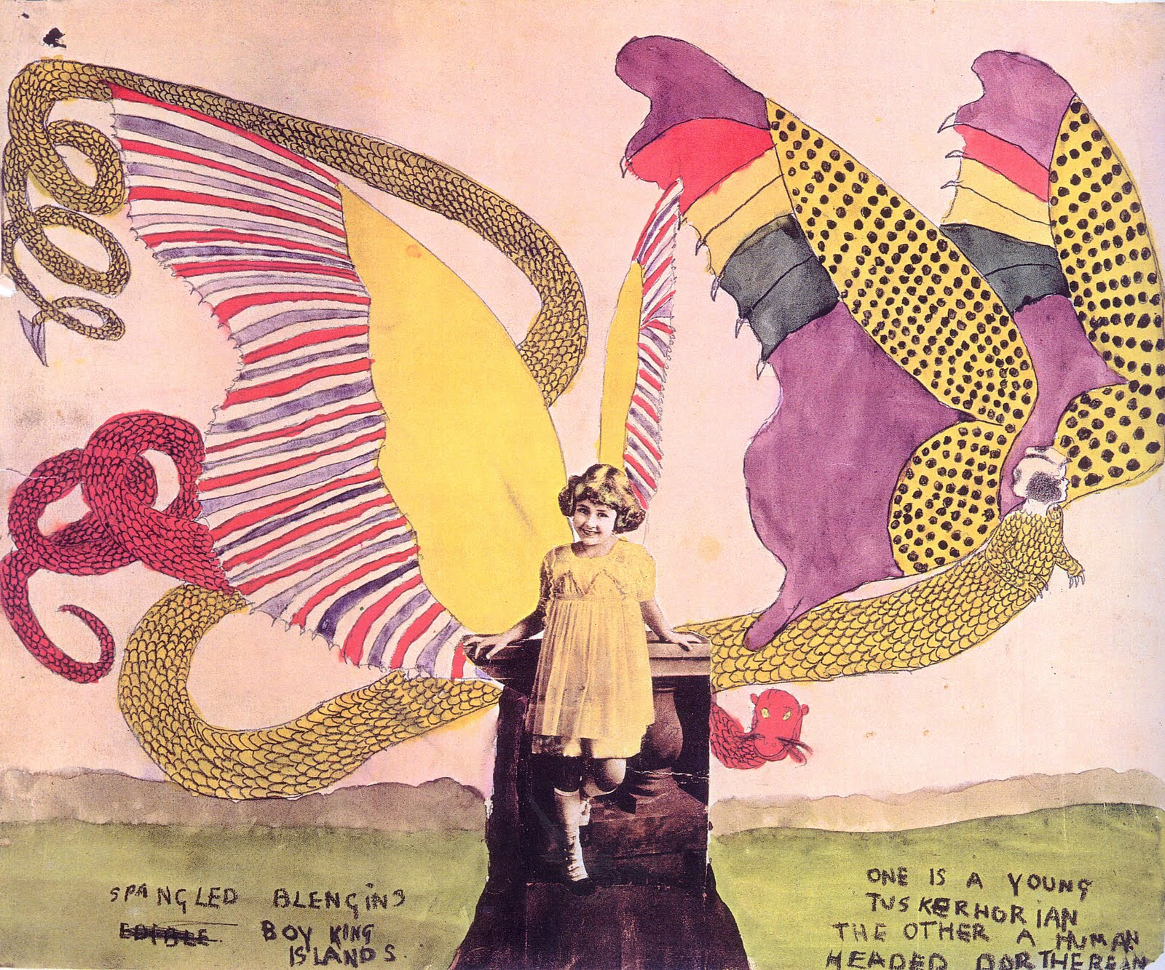

Slide 34
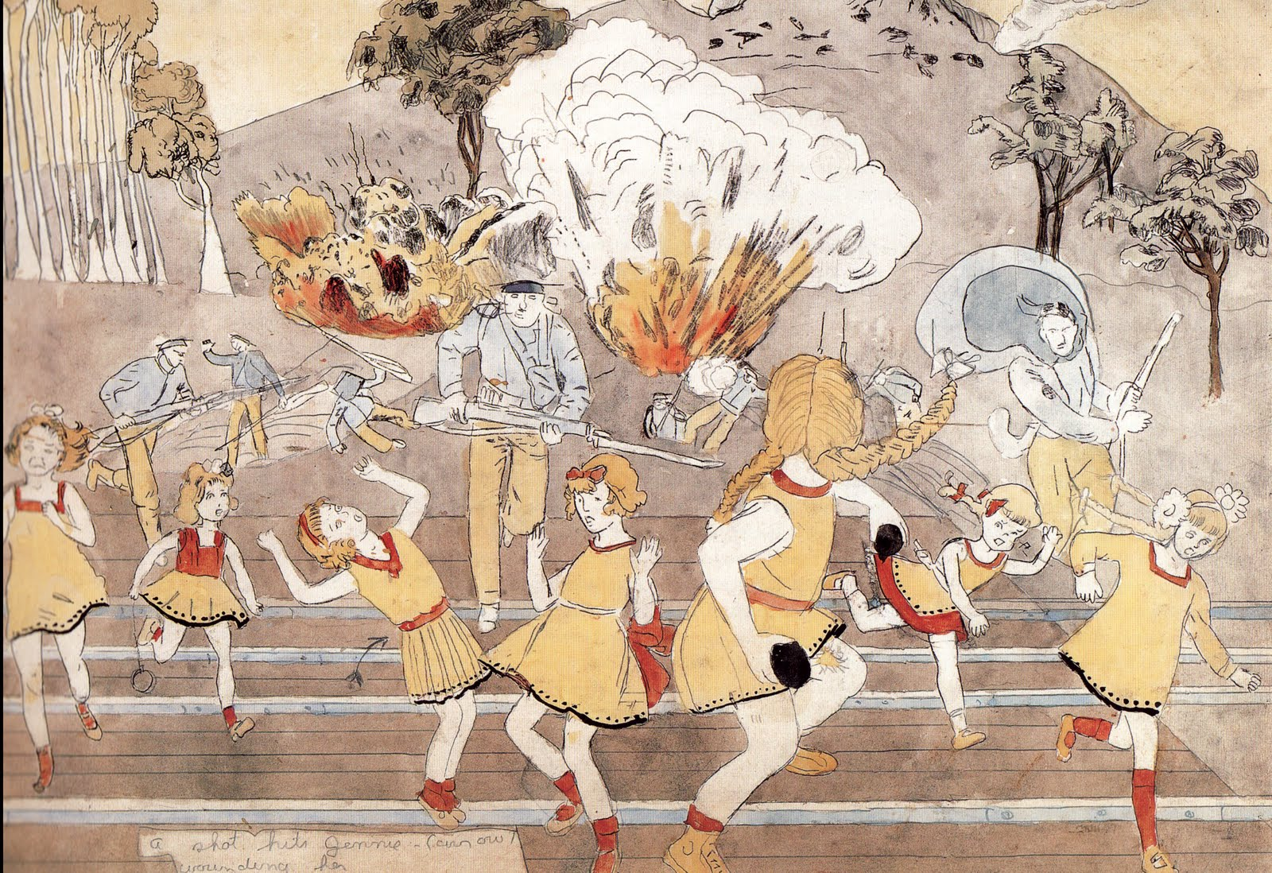

Slide 35
Marcel Dzama

Slide 36
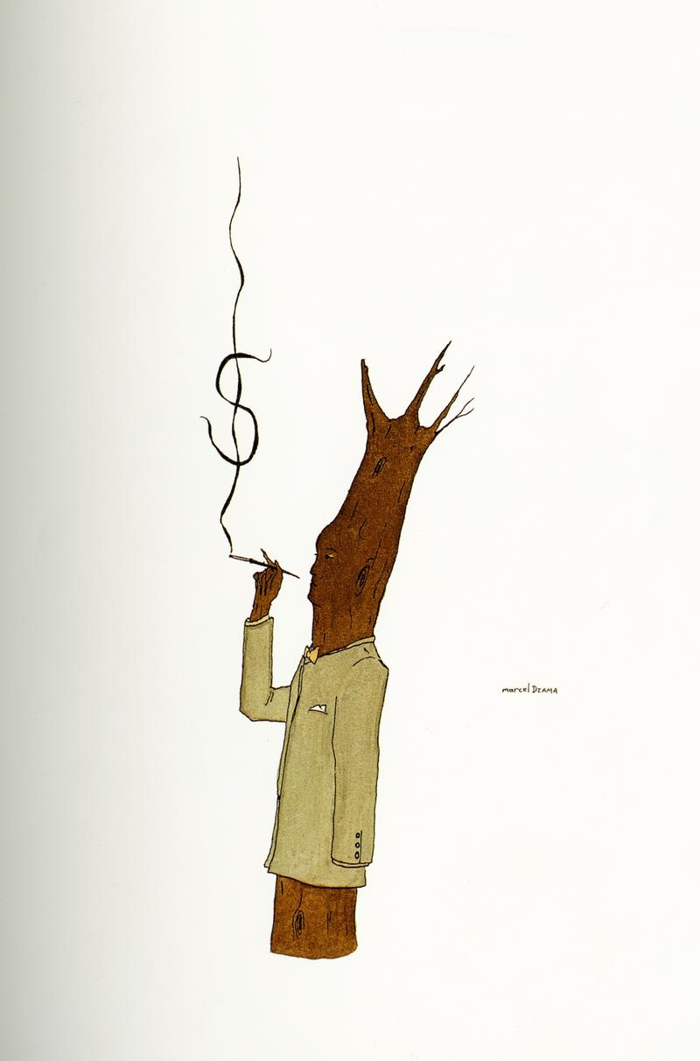

Slide 37
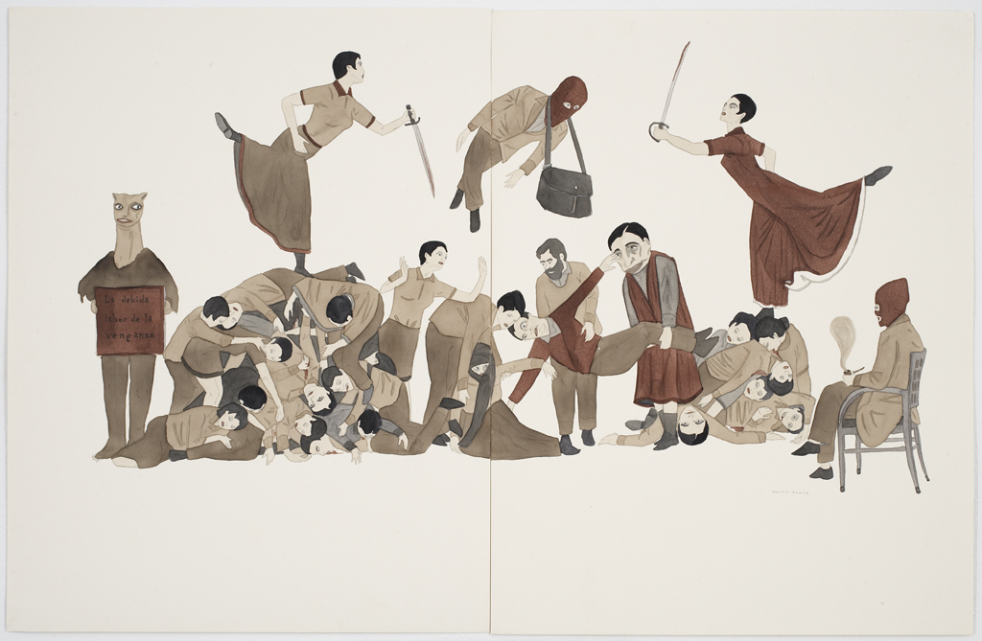

Slide 38
Phillip Guston

Slide 39
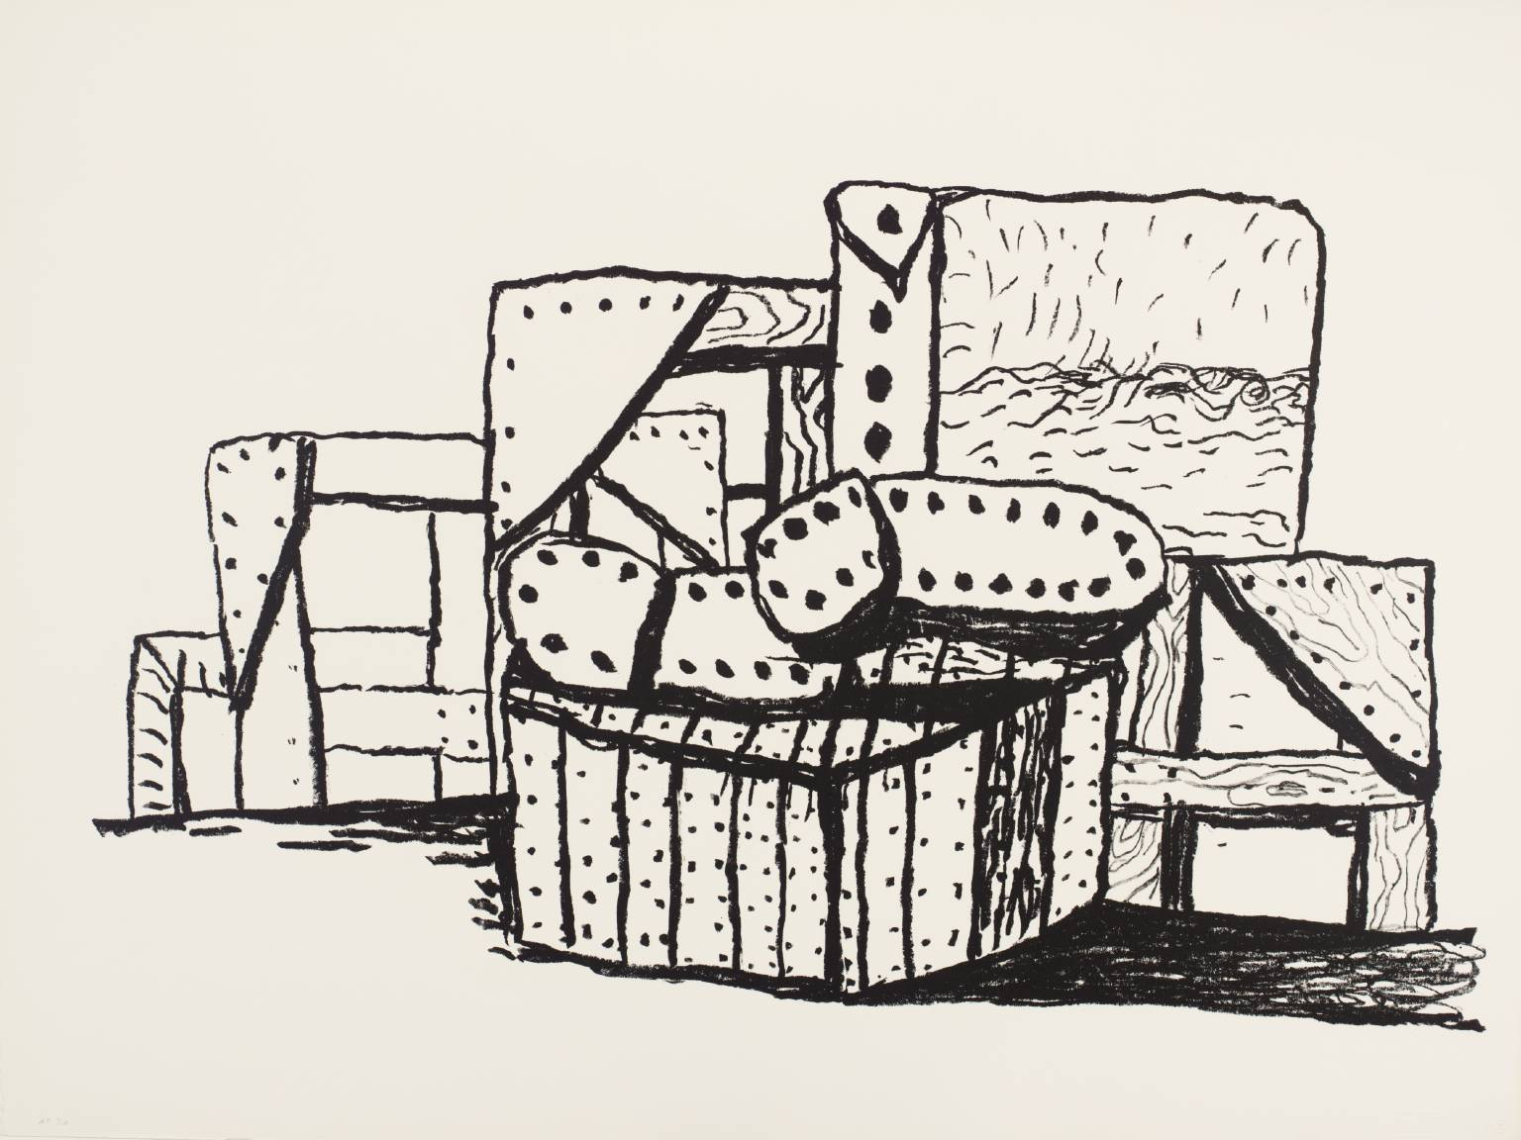

Slide 40
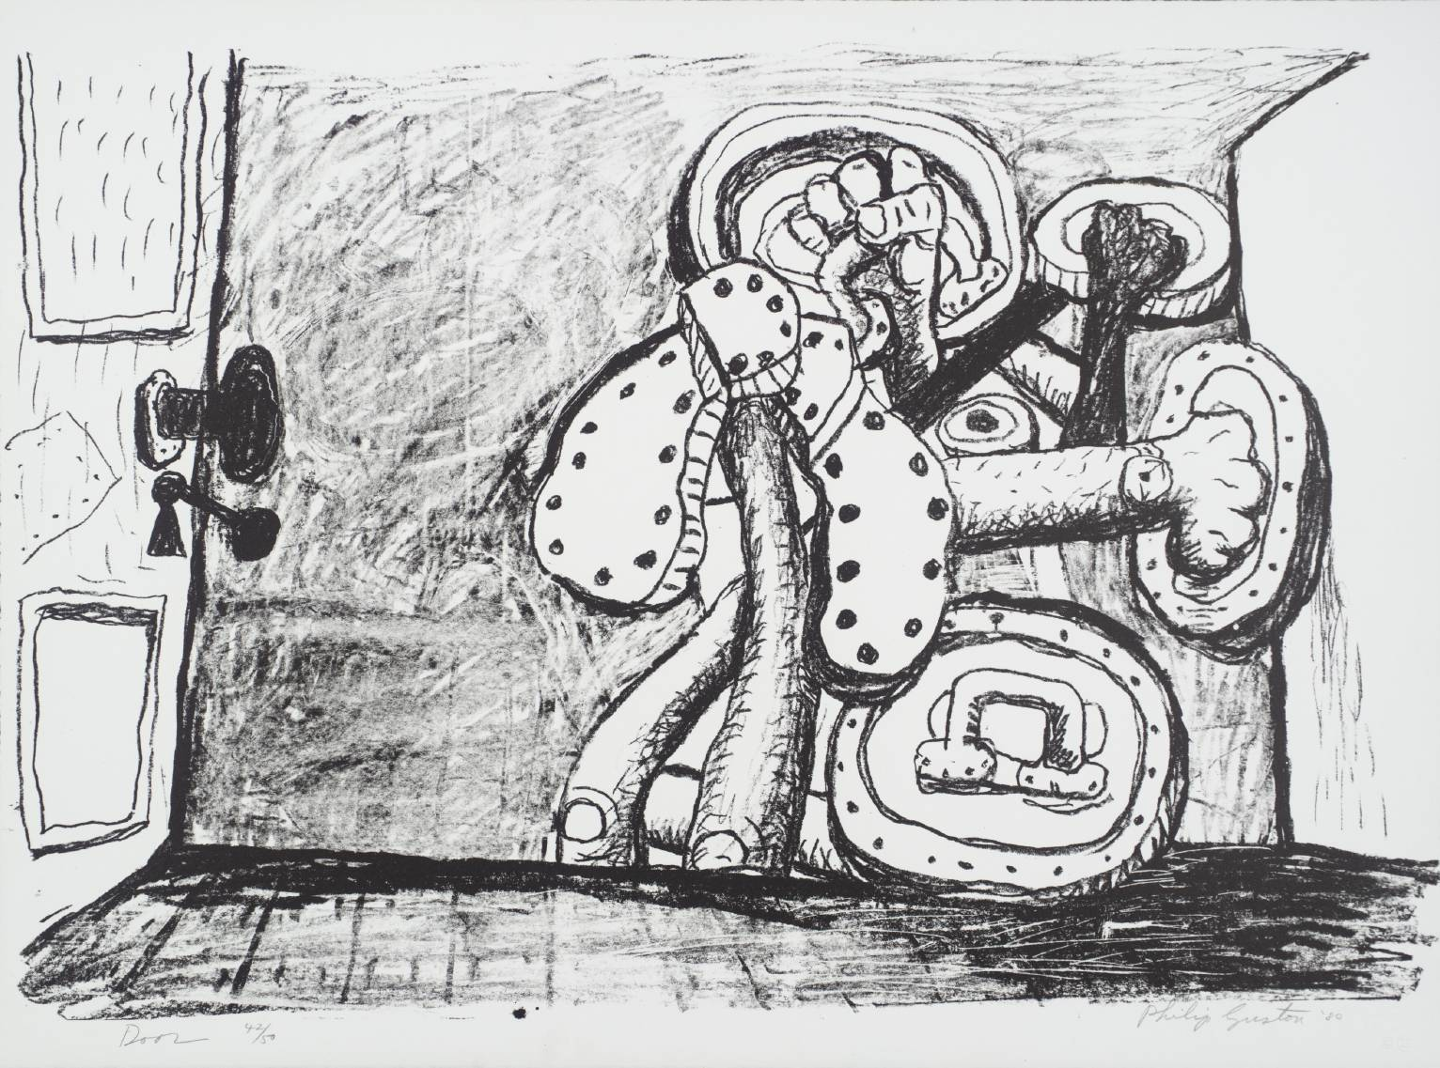

Slide 41
David Hockney

Slide 42
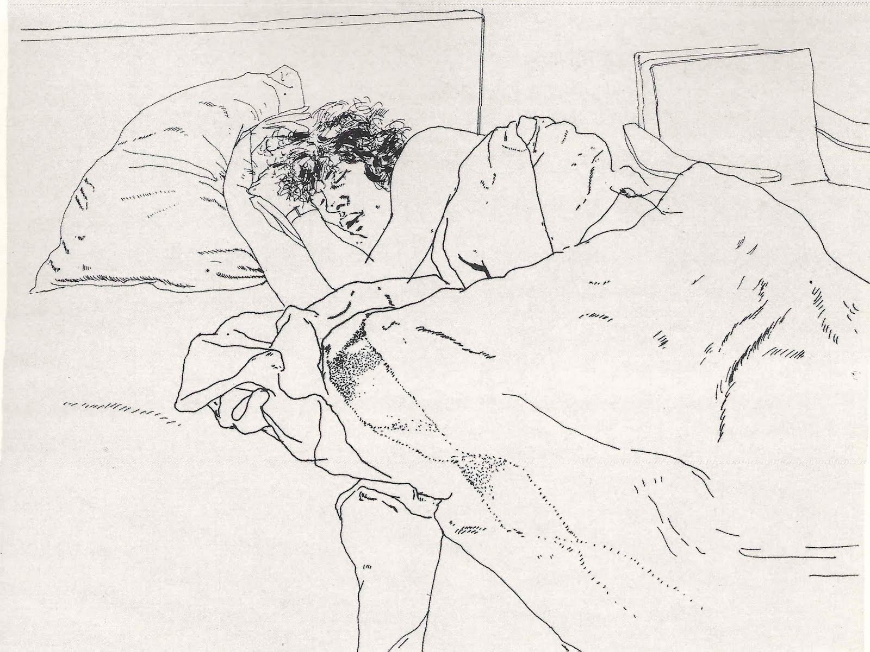

Slide 43
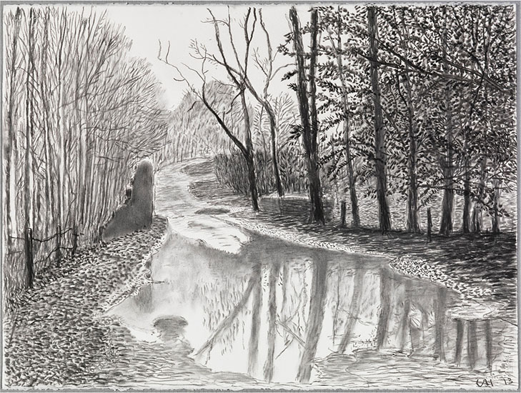

Slide 44
David Horsey

Slide 45



Slide 46
Kim Jung Gi

Slide 47
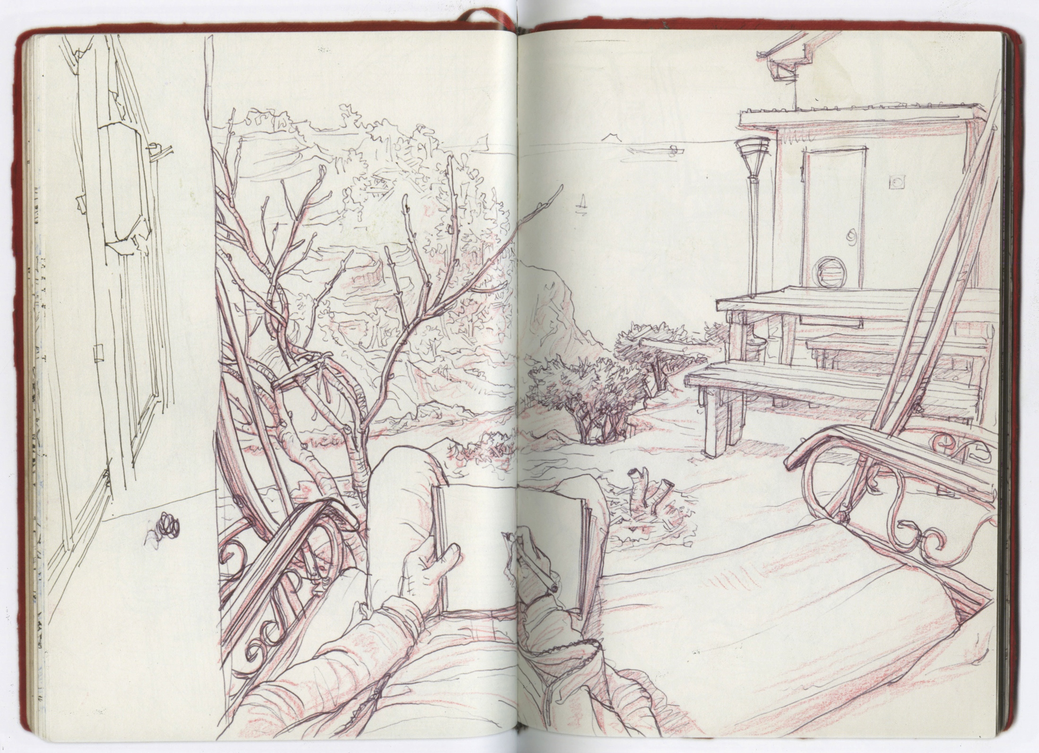

Slide 48
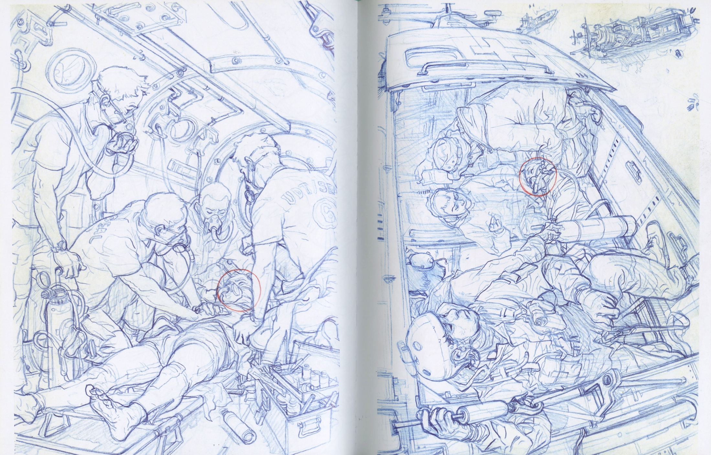

Slide 49
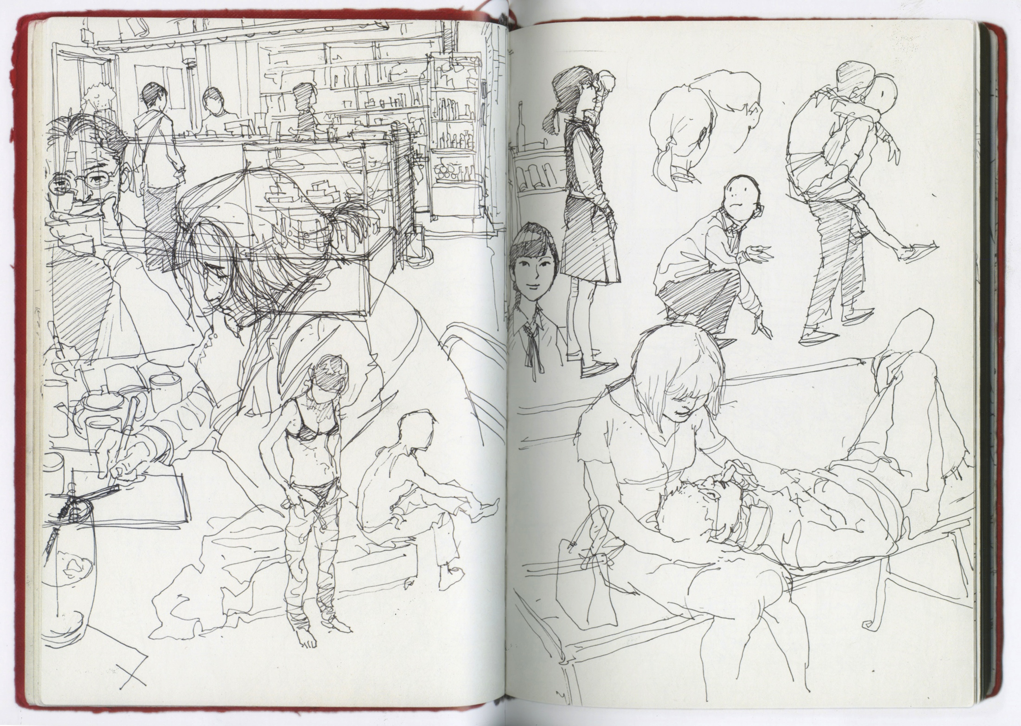

Slide 50
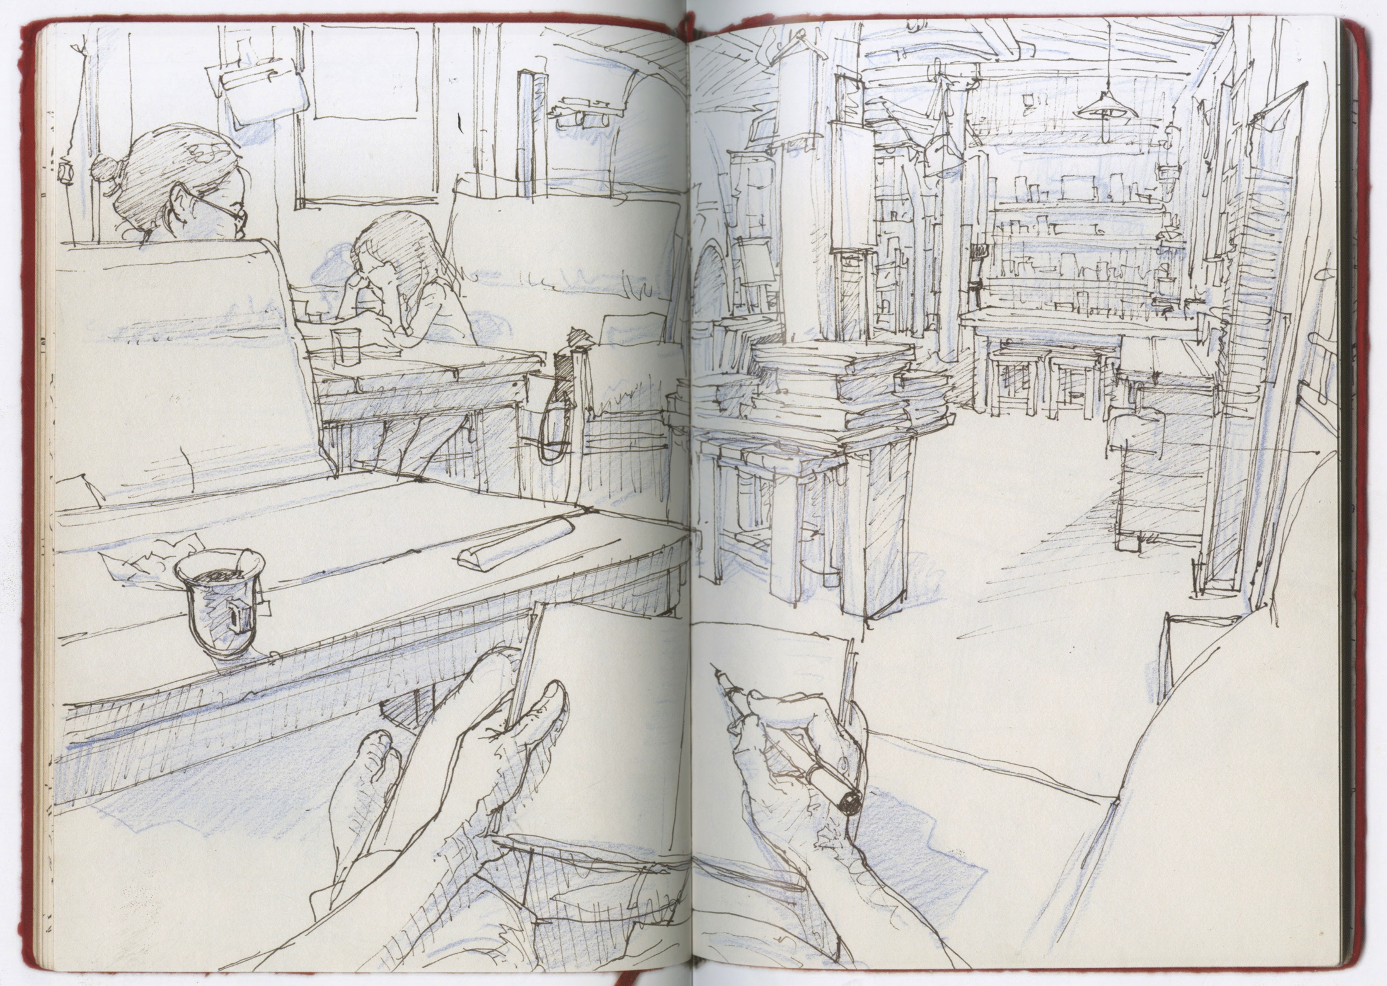

Slide 51
Martin Kippenberger

Slide 52
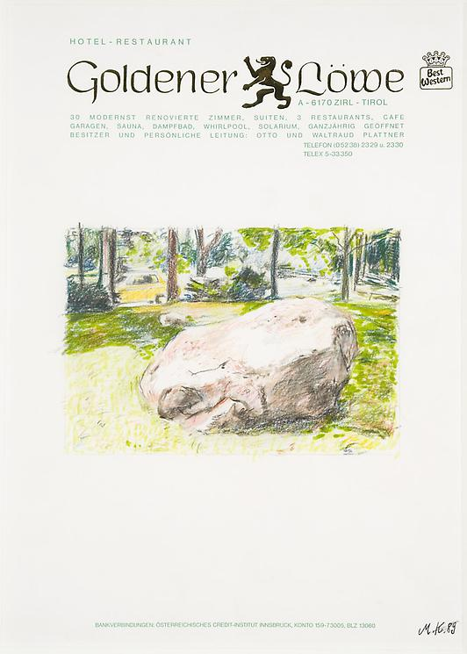

Slide 53
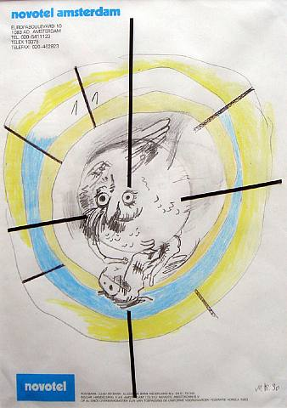

Slide 54
Franz Kline

Slide 55
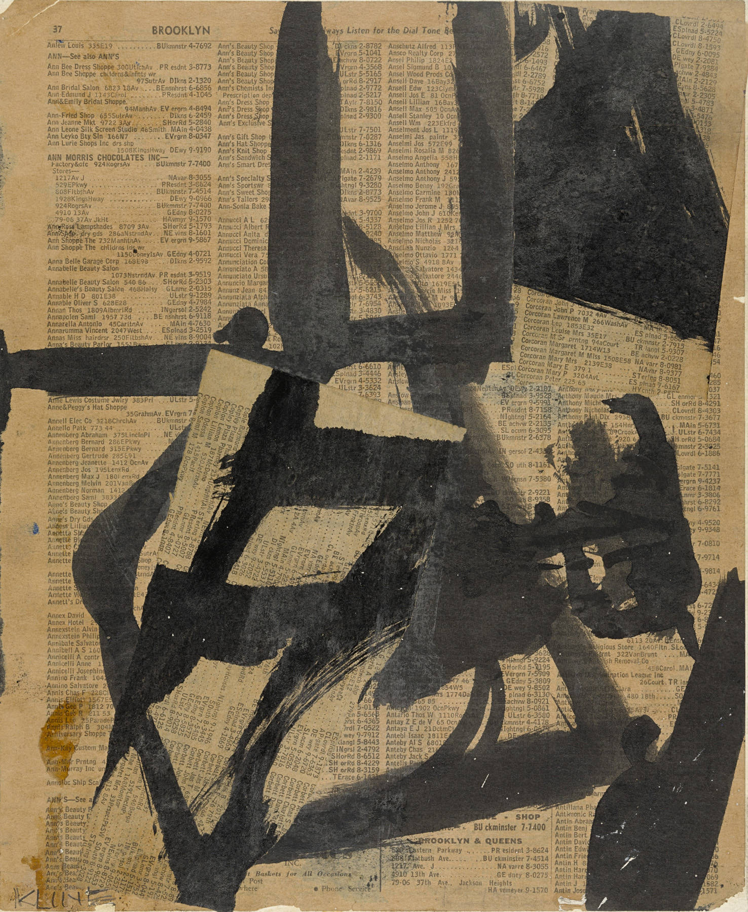

Slide 56
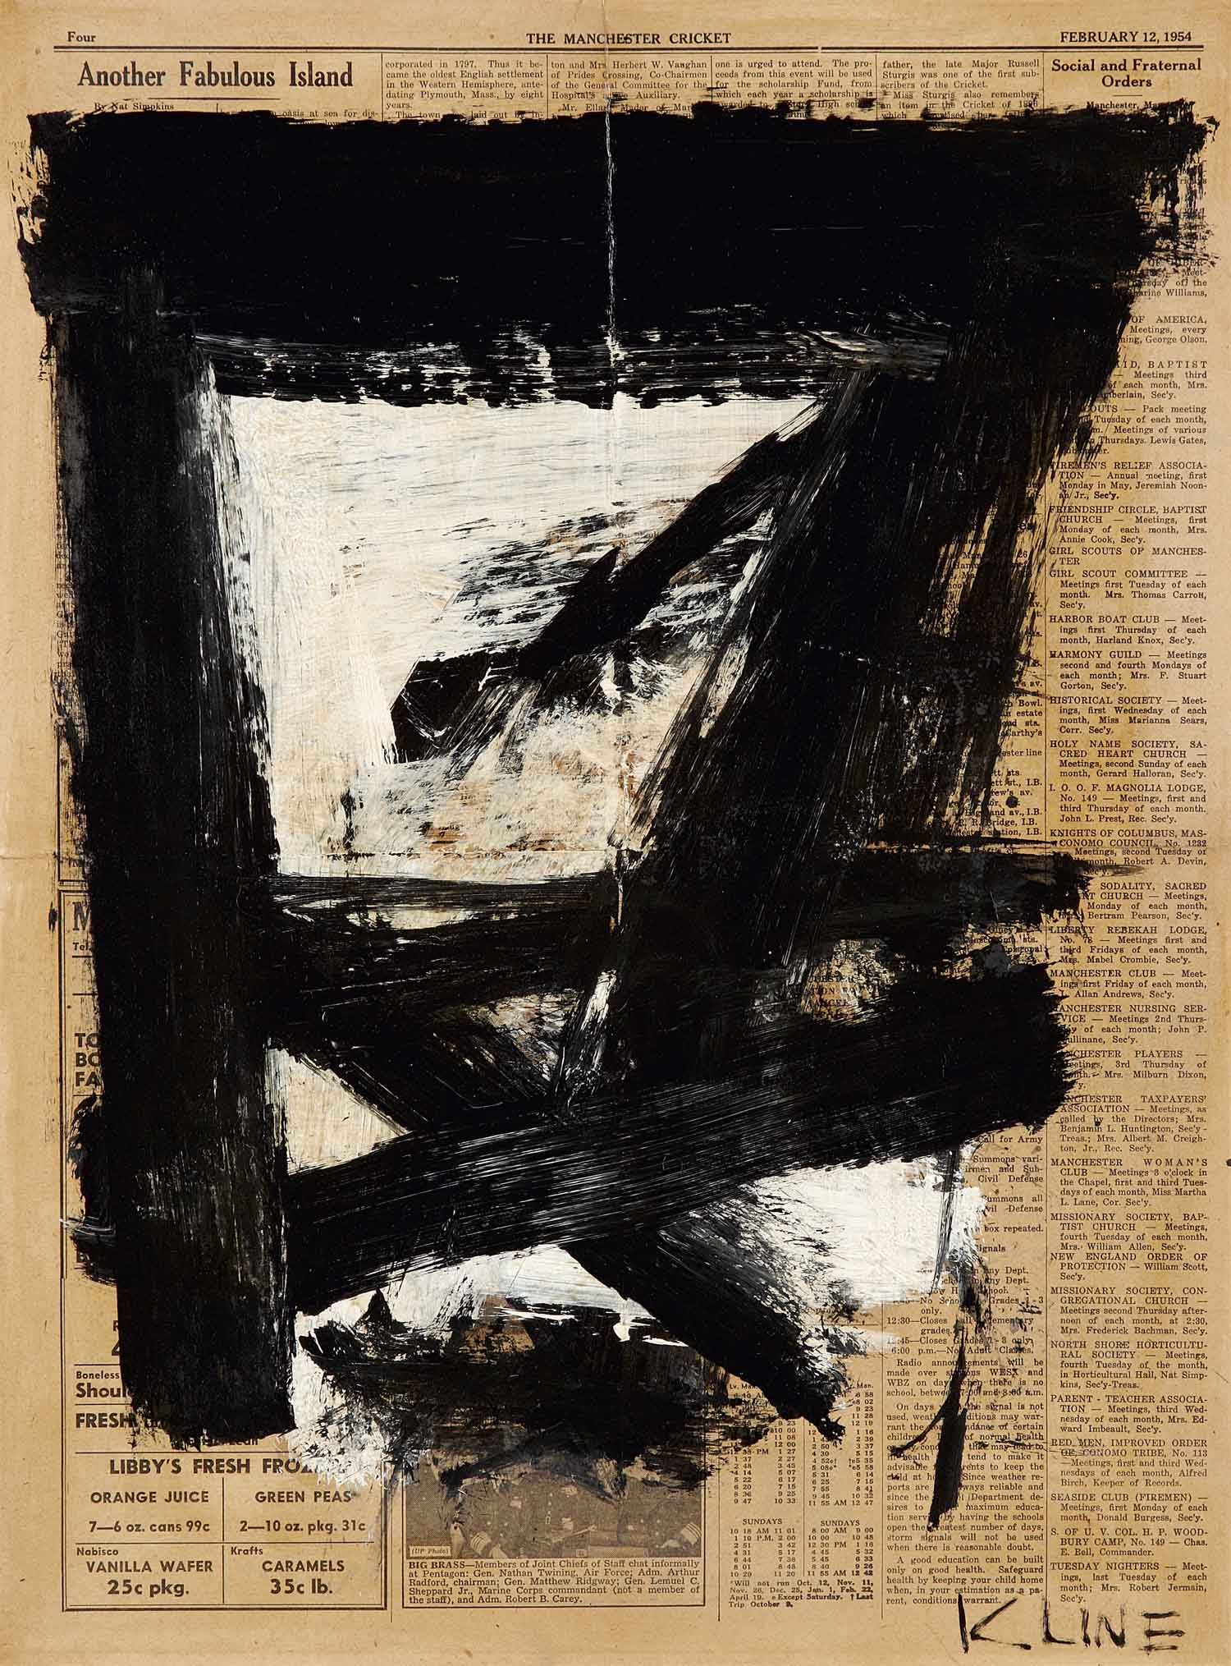

Slide 57
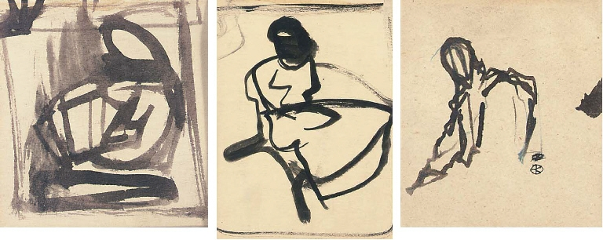

Slide 58
Charles LaBelle

Slide 59
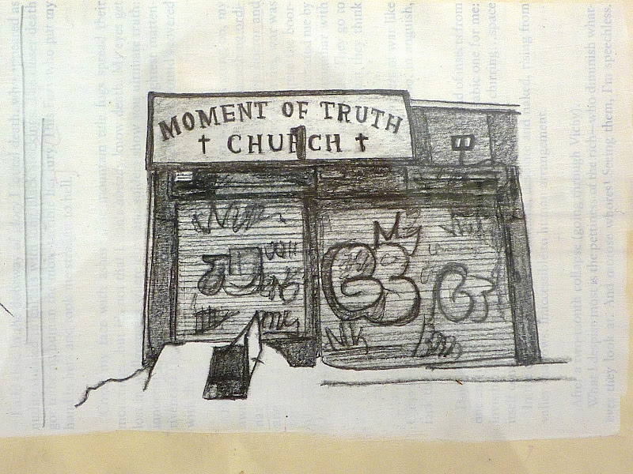

Slide 60
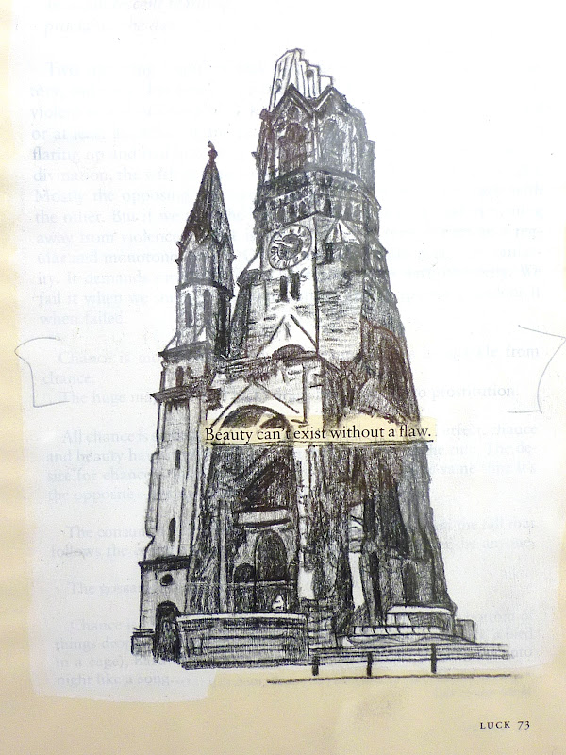

Slide 61
Le Corbusier

Slide 62
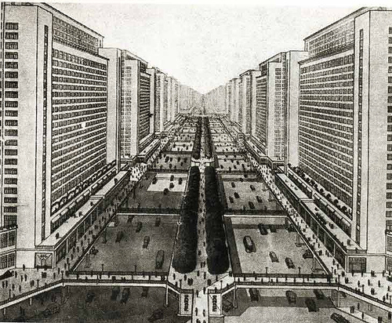
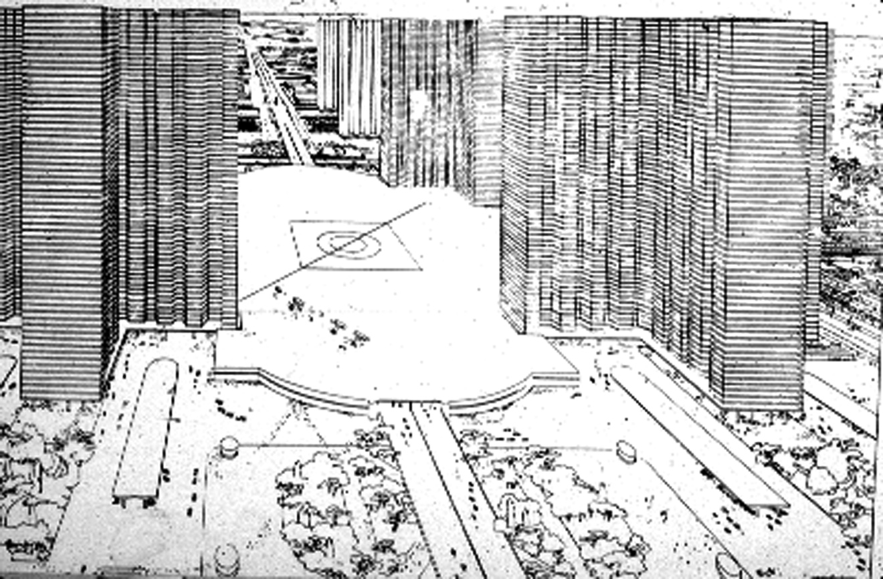

Slide 63
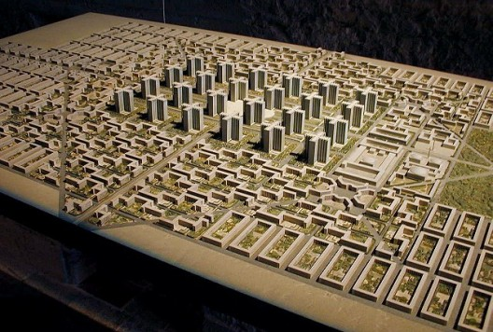

Slide 64
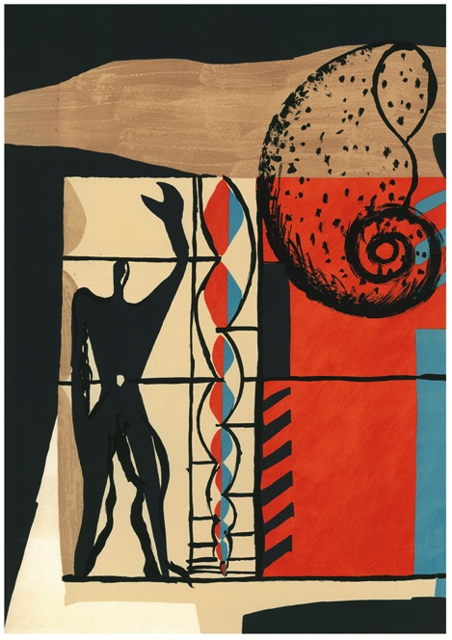
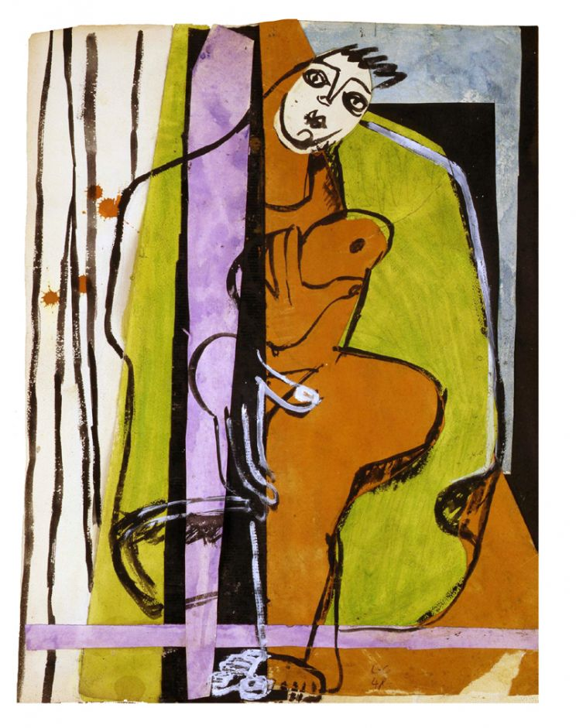

Slide 65
Antonio

Slide 66
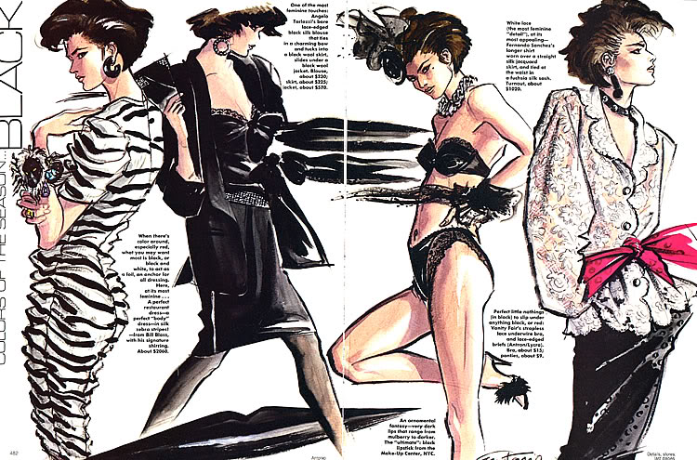

Slide 67
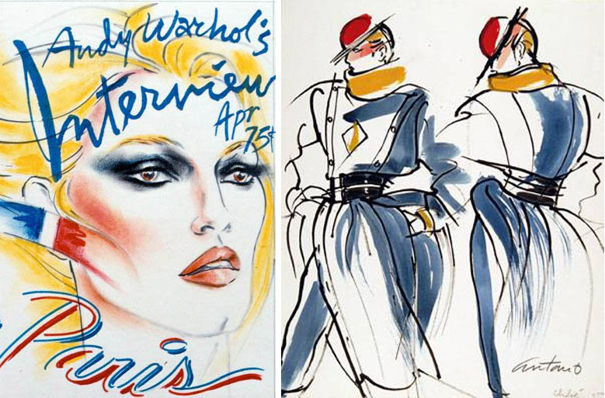

Slide 68
Matt Mahurin

Slide 69


Slide 70


Slide 71



Slide 72
Julie Mehretu

Slide 73


Slide 74


Slide 75


Slide 76
Claes Oldenburg

Slide 77


Slide 78
Laura Owens

Slide 79


Slide 80
Jackson Pollock

Slide 81


Slide 82


Slide 83


Slide 84
Pierre-Paul Prud’hon

Slide 85


Slide 86


Slide 87


Slide 88
Matthew Ritchie

Slide 89


Slide 90


Slide 91
Rembrandt

Slide 92


Slide 93


Slide 94
Renoir

Slide 95


Slide 96


Slide 97
Ed Ruscha

Slide 98



Slide 99


Slide 100



Slide 101


Slide 102


Slide 103
Steve Skroce

Slide 104


Slide 105


Slide 106
Jim Shaw

Slide 107



Slide 108



Slide 109
Vincent van Gogh

Slide 110


Slide 111


Slide 112


