Slide 1
LINEAR PERSPECTIVE

Slide 2
LINEAR PERSPECTIVE
Sight Measuring
1 pt. Parallel Perspective
Drawing Ellipses
2 pt. Parallel Perspective

Slide 3
Sight Measuring
LINEAR PERSPECTIVE
• Sight measuring is a method of comparing heights, lengths, widths, angles and distances by using your pencil.
• Sight measuring is not an actual form of measuring and should not be used to translate measurements of length directly to a drawing.

Slide 4
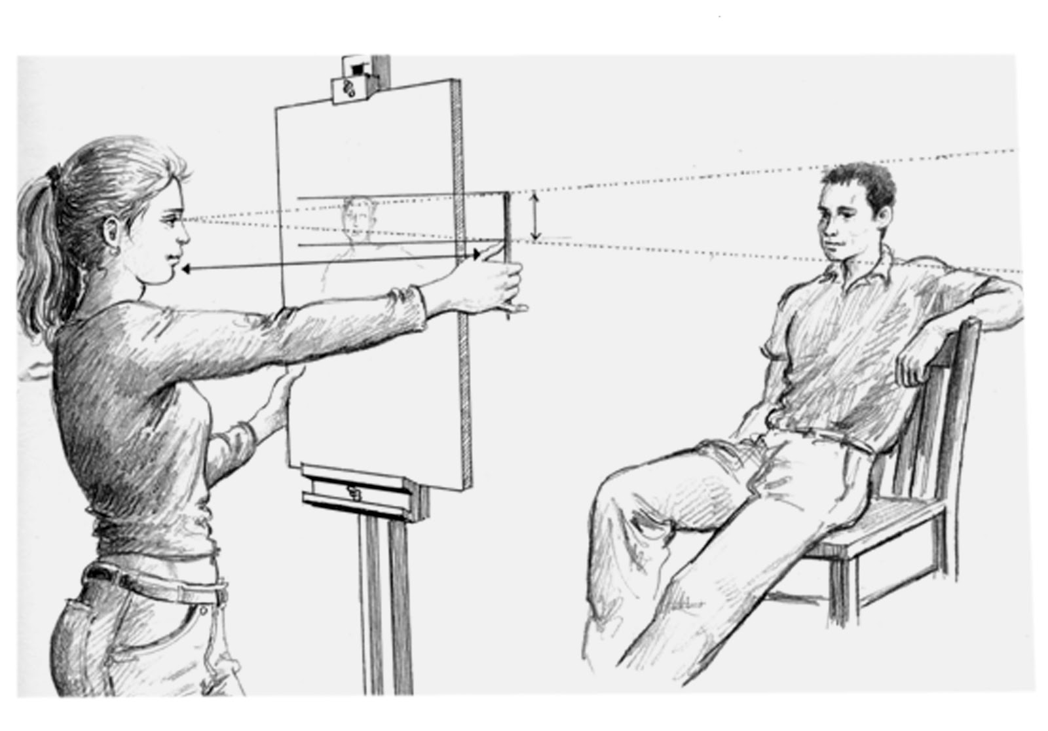
SIGHT MEASURING
While holding your arm completely outstretched, hold your pencil vertically near your eye level.
Align your pencil next to the object you are “sighting” and allow your thumb to slide down the length of the pencil.
When your thumb marks the measurement hold it and use the pencil to compare that length with the length of other objects or parts.

Slide 5
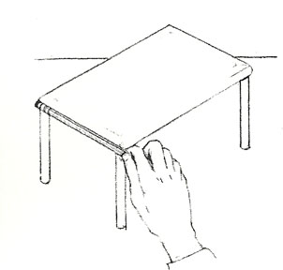
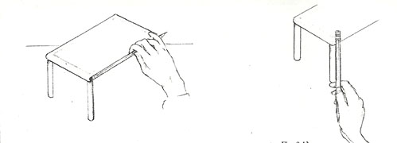
SIGHT MEASURING
You can align your pencil along the lengths of objects or their parts.
Compare the relative lengths of objects or parts.
You will see a proportion. For example, the table is 1.5 times longer than it is high.
Use your fingers to compare the lengths in your drawing.
Make adjustments to your drawing.

Slide 6
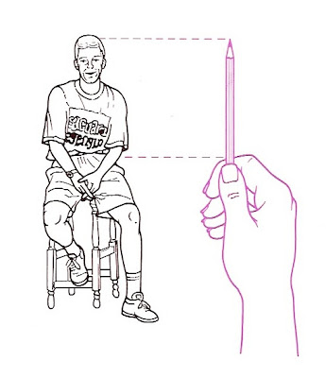
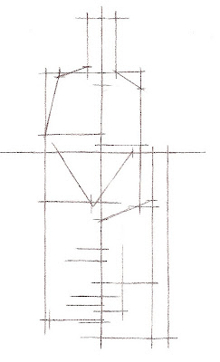
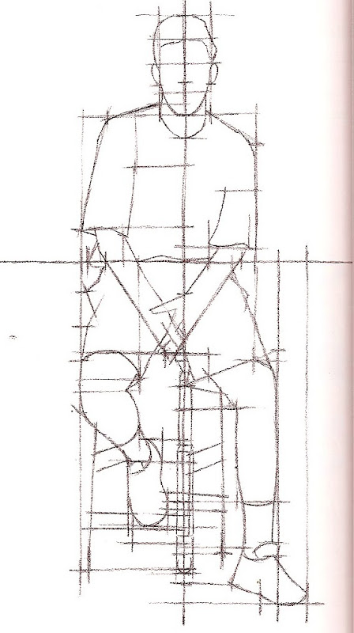
SIGHT MEASURING
By creating guidelines or marks on your paper you can insure that proportions or distances between objects are correct. This can occur before or during the drawing process.

Slide 7
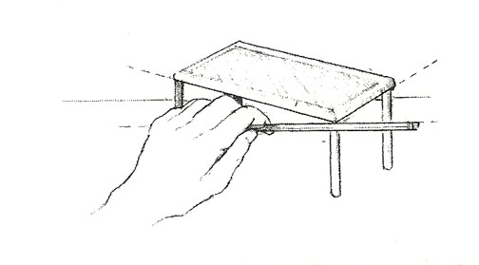
SIGHT MEASURING
Sight measuring is also helpful in
finding angles.
With arm outstretched align the pencil vertically or horizontally against the angle you wish to measure.
This will allow you to see the angle created between the pencil and the edge of the object.
Approximate the same angle on your drawing.

Slide 8
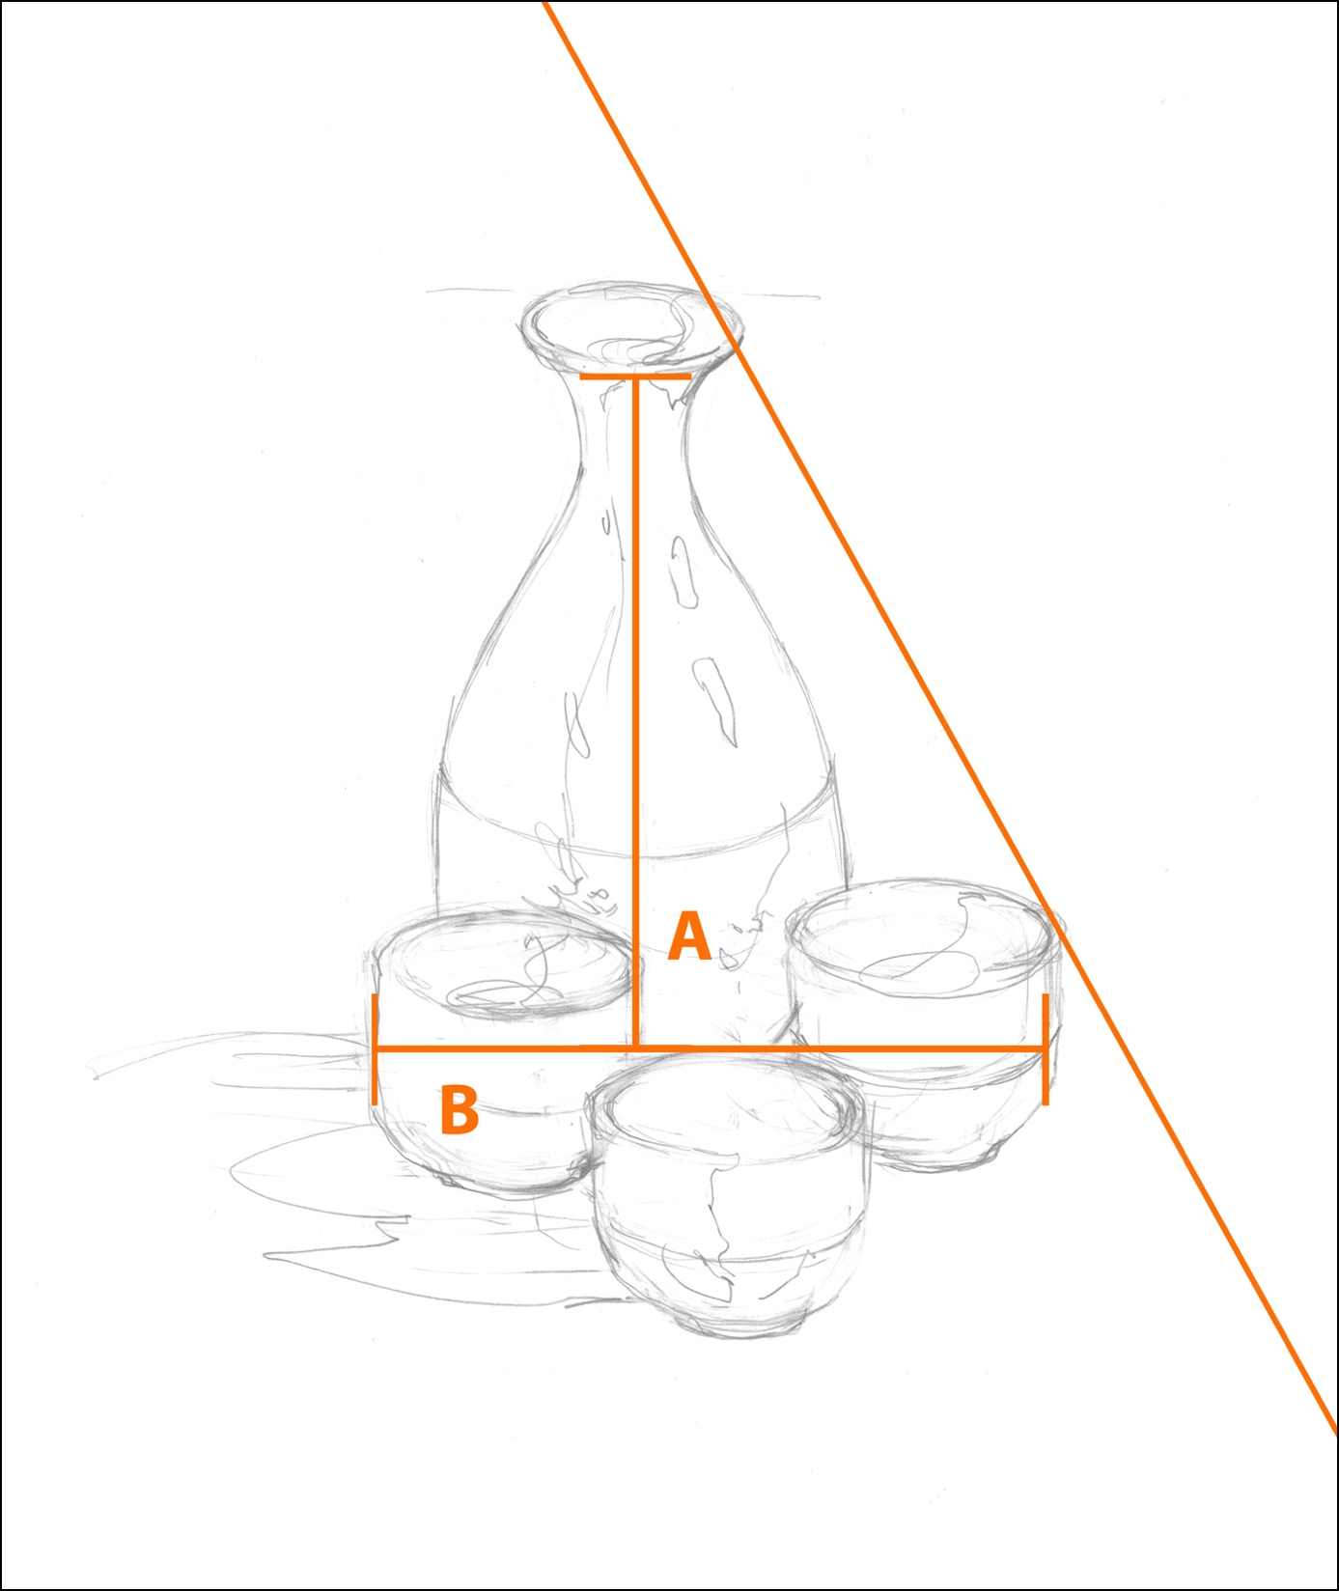
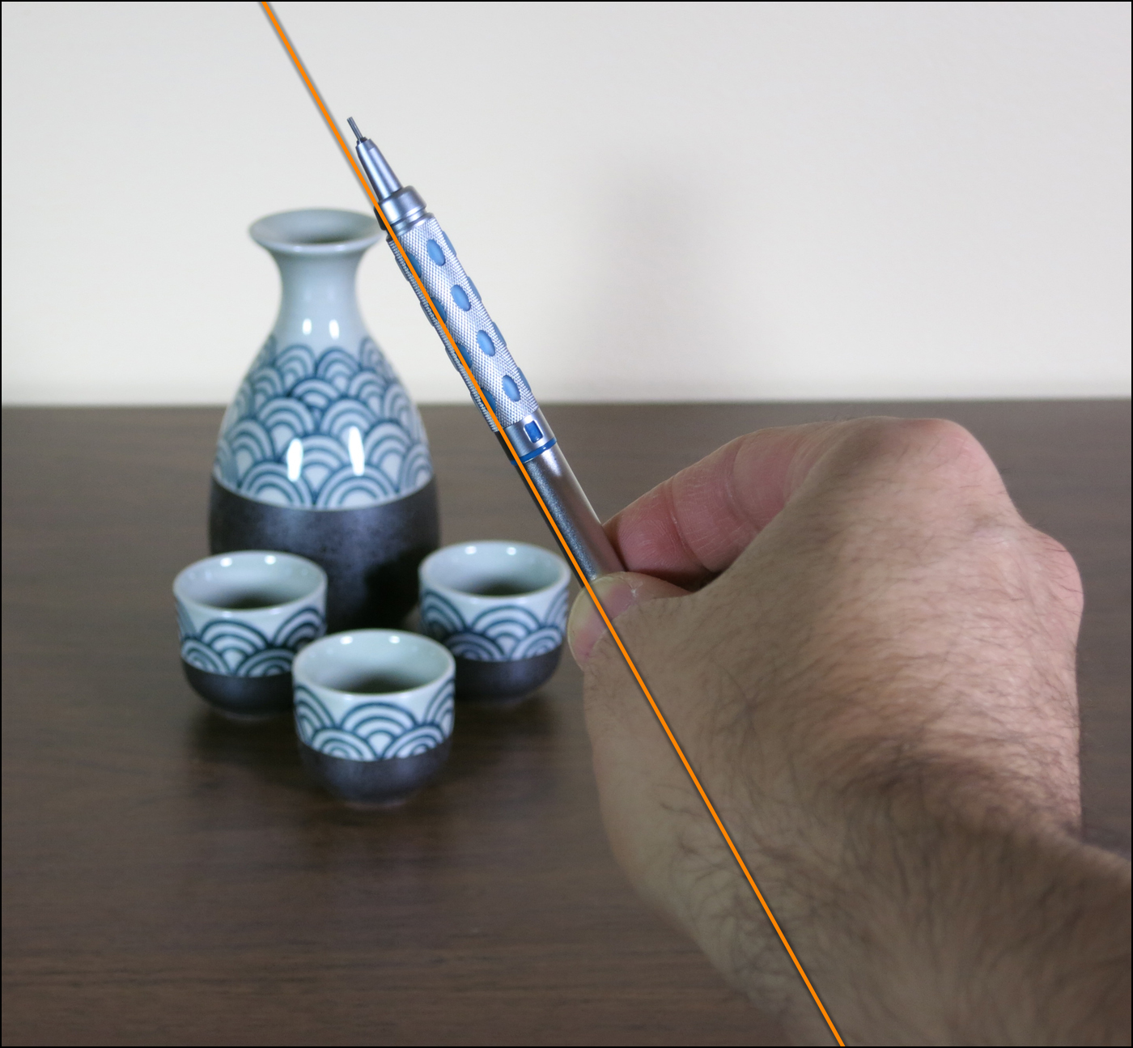
SIGHT MEASURING

Slide 9
1 POINT PARALLEL PERSPECTIVE

Slide 17
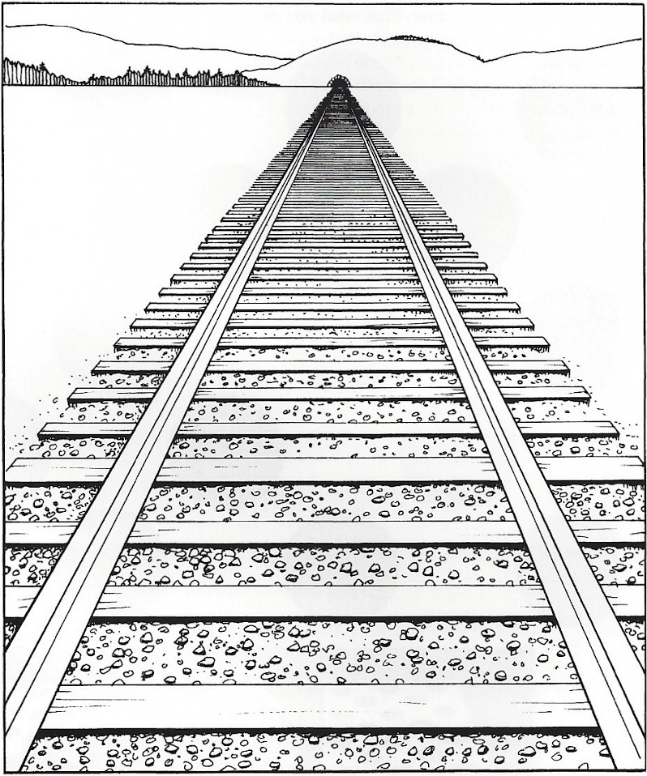
1 POINT PARALLEL PERSPECTIVE
1 pt. Parallel Perspective illustrates how parallel lines seem to converge at a single point (the vanishing point).
The horizon line represents the eye level of the person who draws the picture.
Notice that all horizontal lines are parallel to the horizon.
The intervals between railroad ties and the ties themselves diminish in size because they are receding in space.

Slide 18
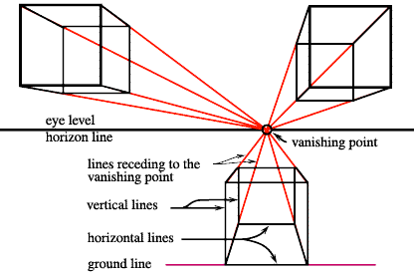
1 POINT PARALLEL PERSPECTIVE

Slide 19
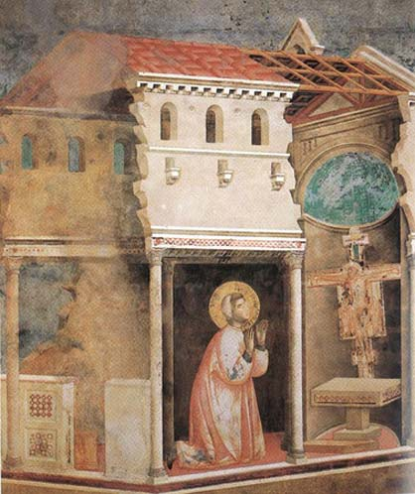
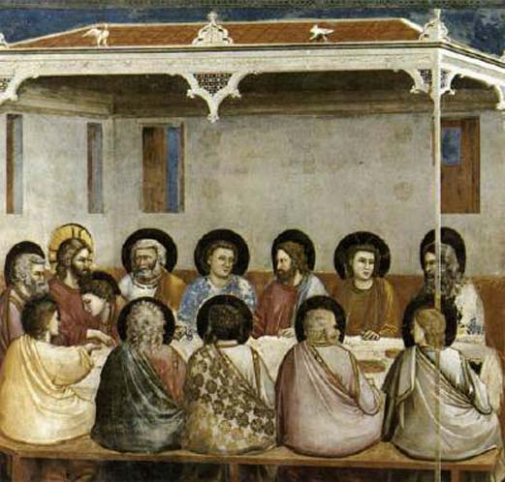
1 POINT PARALLEL PERSPECTIVE
Paintings by Giotto (1226-1337)

Slide 20
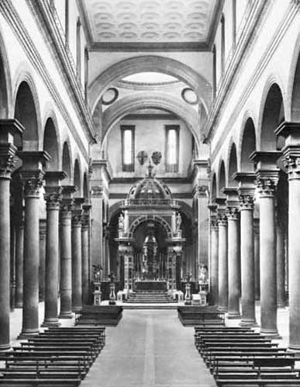
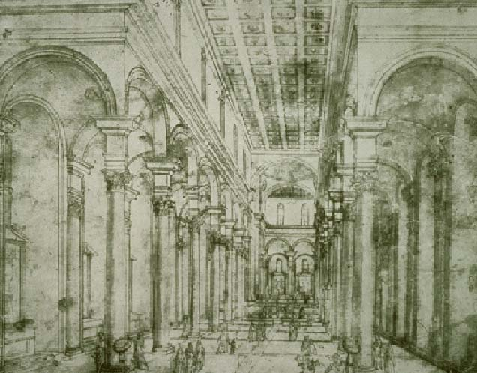
1 POINT PARALLEL PERSPECTIVE
Drawing/Architecture by Brunelleschi (1337-1446)

Slide 21
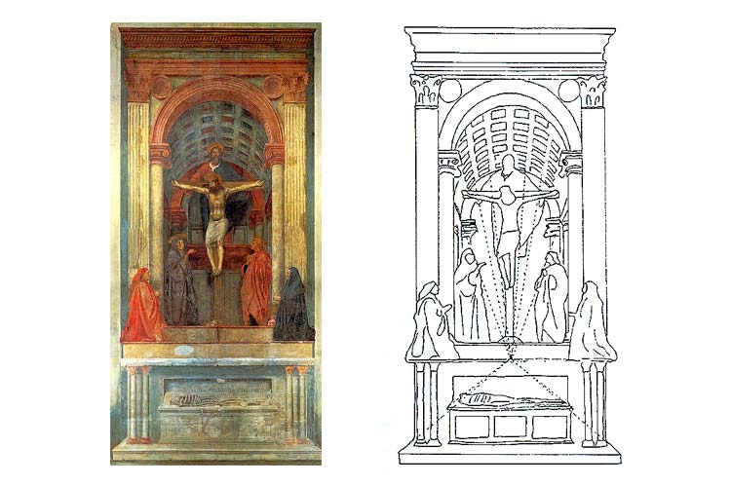
1 POINT PARALLEL PERSPECTIVE
Paintings by Massacio (1401-1428)

Slide 22
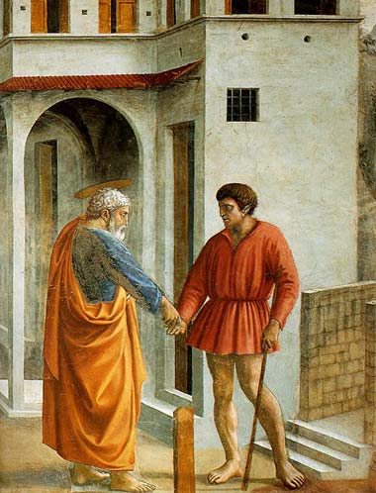
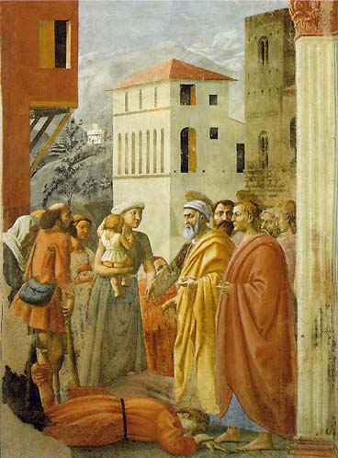
1 POINT PARALLEL PERSPECTIVE

Slide 23
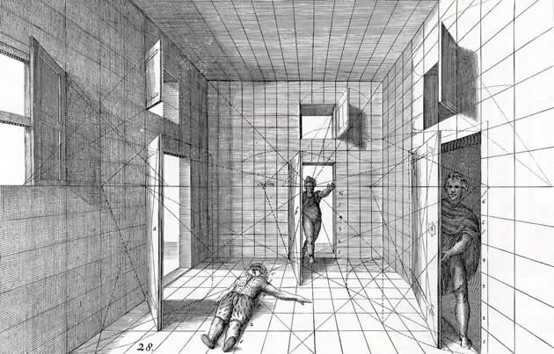
1 POINT PARALLEL PERSPECTIVE
Drawing by Hans Vredeman de Vries (1527-1607)

Slide 24
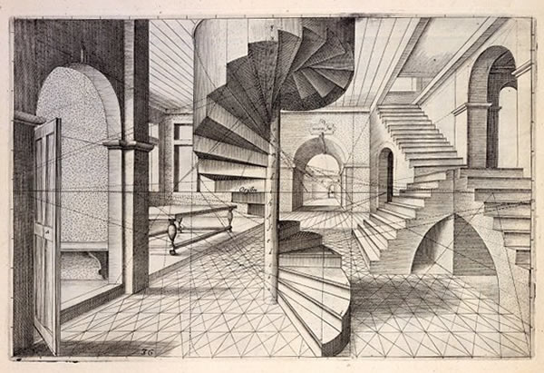
1 POINT PARALLEL PERSPECTIVE
Drawing by Samuel Marolois (1572-1627)

Slide 25
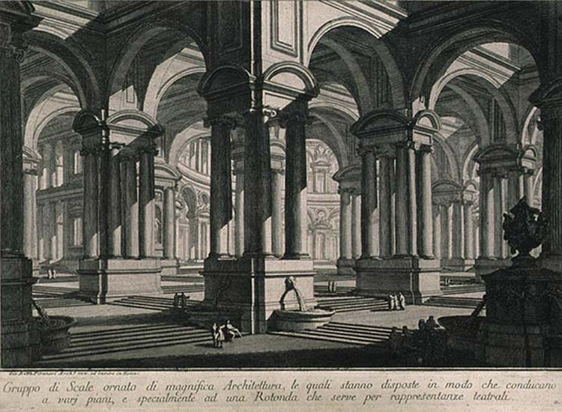
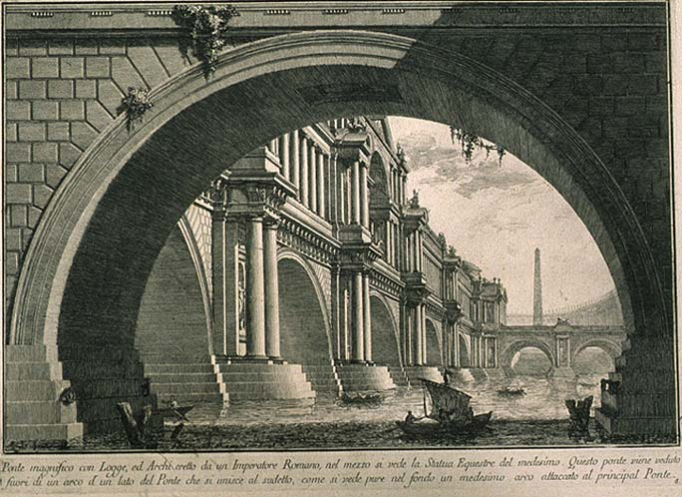
1 POINT PARALLEL PERSPECTIVE
Etchings by Piranesi (1720-1778)

Slide 26
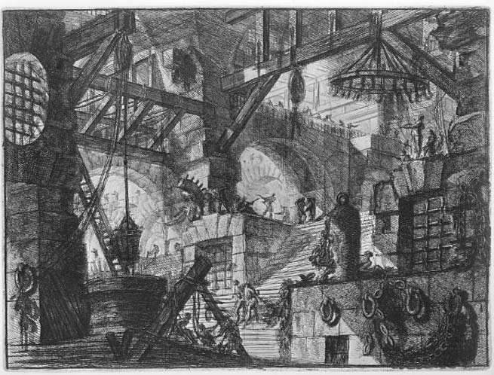
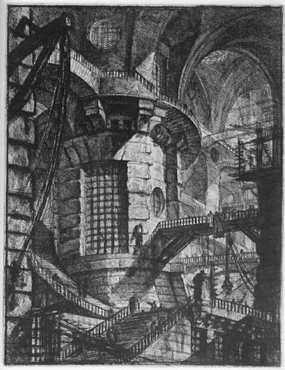
1 POINT PARALLEL PERSPECTIVE

